Slide 1
Welcome to 6PR’s Assembly - Being Safe Online
Notes:
6PR had their class assembly today and this video and Powerpoint presentation shows how all their effort paid off fantastically well! Each slide was made by the children during the past few ICT lessons to summarise their learning about online safety and creating presentations. We are very proud of them all and hope they are also proud of themselves.

Slide 2
Only talk to people you know and trust online
Notes:
When you are playing online, it is very important you do not talk to strangers because you might not be able to trust them.

Slide 3
INTERNET SAFTEY
Do not talk to strangers online.
Notes:
JAHARI, Elliot, Farhan, Mijanur
JAHARI;THESE ARE OUR INTERNET SAFTEY HEAROS.

Slide 4
Be Internet Safety HEROES!
DON’T DOWNLOAD THINGS YOU THINK WILL UPSET OR HURT YOU.
DON’T TALK TO SRANGERS BECAUSE THEY MIGHT PRETENED TO KNOW YOU IN REAL LIFE.
Notes:
JAHARI, Elliot, Farhan, Mijanur

Slide 5
SCAMMING!
Notes:
Bethany, Isabelle, Shadecia, Esen

Slide 6
So how do we keep safe online?
Never Download From Pop ups.
Visit Safe Websites.
Use Tough To Crack Passwords.
Notes:
Bethany, Isabelle, Shadecia, Esen

Slide 7
After School Club
Welcome, today our topic is…
ONLINE SAFETY
Notes:
Sumeya, Amina, Tunjida, Aaliyah

Slide 8
Online Safety!
Find a friend you can trust.
Double check your privacy settings.
Think before you send or post.
Do not click too quick.
Tell a trusted adult if you receive a friend request.
Notes:
Sumeya, Amina, Tunjida, Aaliyah

Slide 9
Lets talk about …
Notes:
Ozge and Riona
Hey everyone we know we all talk online but sometimes we can talk to the wrong people. Online people ca
n say some pretty mean stuff that can hurt you and even scare you.
That’s called cyber bulling as you most likely know a lot about by now
.the people that talk to you are strangers and you most likely you don’t know them.
This is why we want to talk to you about it.

Slide 10
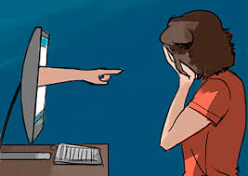
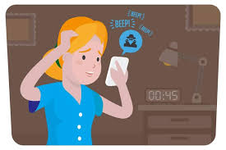
You don’t have to be a Cyber Bully!!!
Notes:
Ozge and Riona

Slide 11
Cyber Bullying
People say mean and hurtful things.
Be careful when playing games online.
If you wouldn’t say it in real life don’t say it online either.
Speak to a trusted adult.
Notes:
Ozge and Riona
So remember to stay safe and only talk to the people you know

Slide 12
Notes:
Claire, Nabilah, Eliana, Ibrahim, Kayleigh and Leslie

Slide 13
TOP TIPS
Does someone or something make you feel uncomfortable?
Tell a trusted adult.
Is someone asking for your identity or personal information?
Block them, Delete them and tell a trusted adult.
Identity = your name, account, phone number, address etc.
Notes:
Claire, Nabilah, Eliana, Ibrahim, Kayleigh and Leslie

Slide 14
Are YOU being safe?
If you’re not being safe on the internet, you could divulge your private information without even realising it.
Notes:
Claire, Nabilah, Eliana, Ibrahim, Kayleigh and Leslie

Slide 15
Stay Safe Online!
Pop ups
Notes:
Aliye Mina and Beyza
Hello today we will be talking about pop ups

Slide 16
What are pop ups?
Pop ups are usually small windows that suddenly appears in the foreground of your screen …
ANNOYING!
Notes:
Aliye Mina and Beyza

Slide 17
Internet Safety
BUGS AND VIRUSES
Notes:
Jayden and The internet is an awesome place to mess around with different links and websites.
Like shopping for underwear!
No not like that silly!
OH
But sometimes websites could cause many corruptions to your computer.
How on earth does a piece of underwear make a computer corrupted? Wait … does my underwear have the flu?
How many times do I have to tell you it’s not like that!
Then HOW does a computer get corrupted?
Well viruses and bugs cause them.

Slide 18
Bugs/viruses could occur because…
- Scam emails
- Suspicious websites
- Bad links
- Dangerous downloads
You can prevent viruses by…
Being careful what you click.
Only use reliable websites.
Only believe trusted sources.
How do you prevent this?
Notes:
Viruses or bugs could cause your computer to get errors
So, if you don’t want to get a virus, don’t chuck your computer into the old lady’s - from upstairs – garden. Otherwise, she will feed your computer bugs!
No! Bugs and viruses occur from these reasons.
-

Slide 19
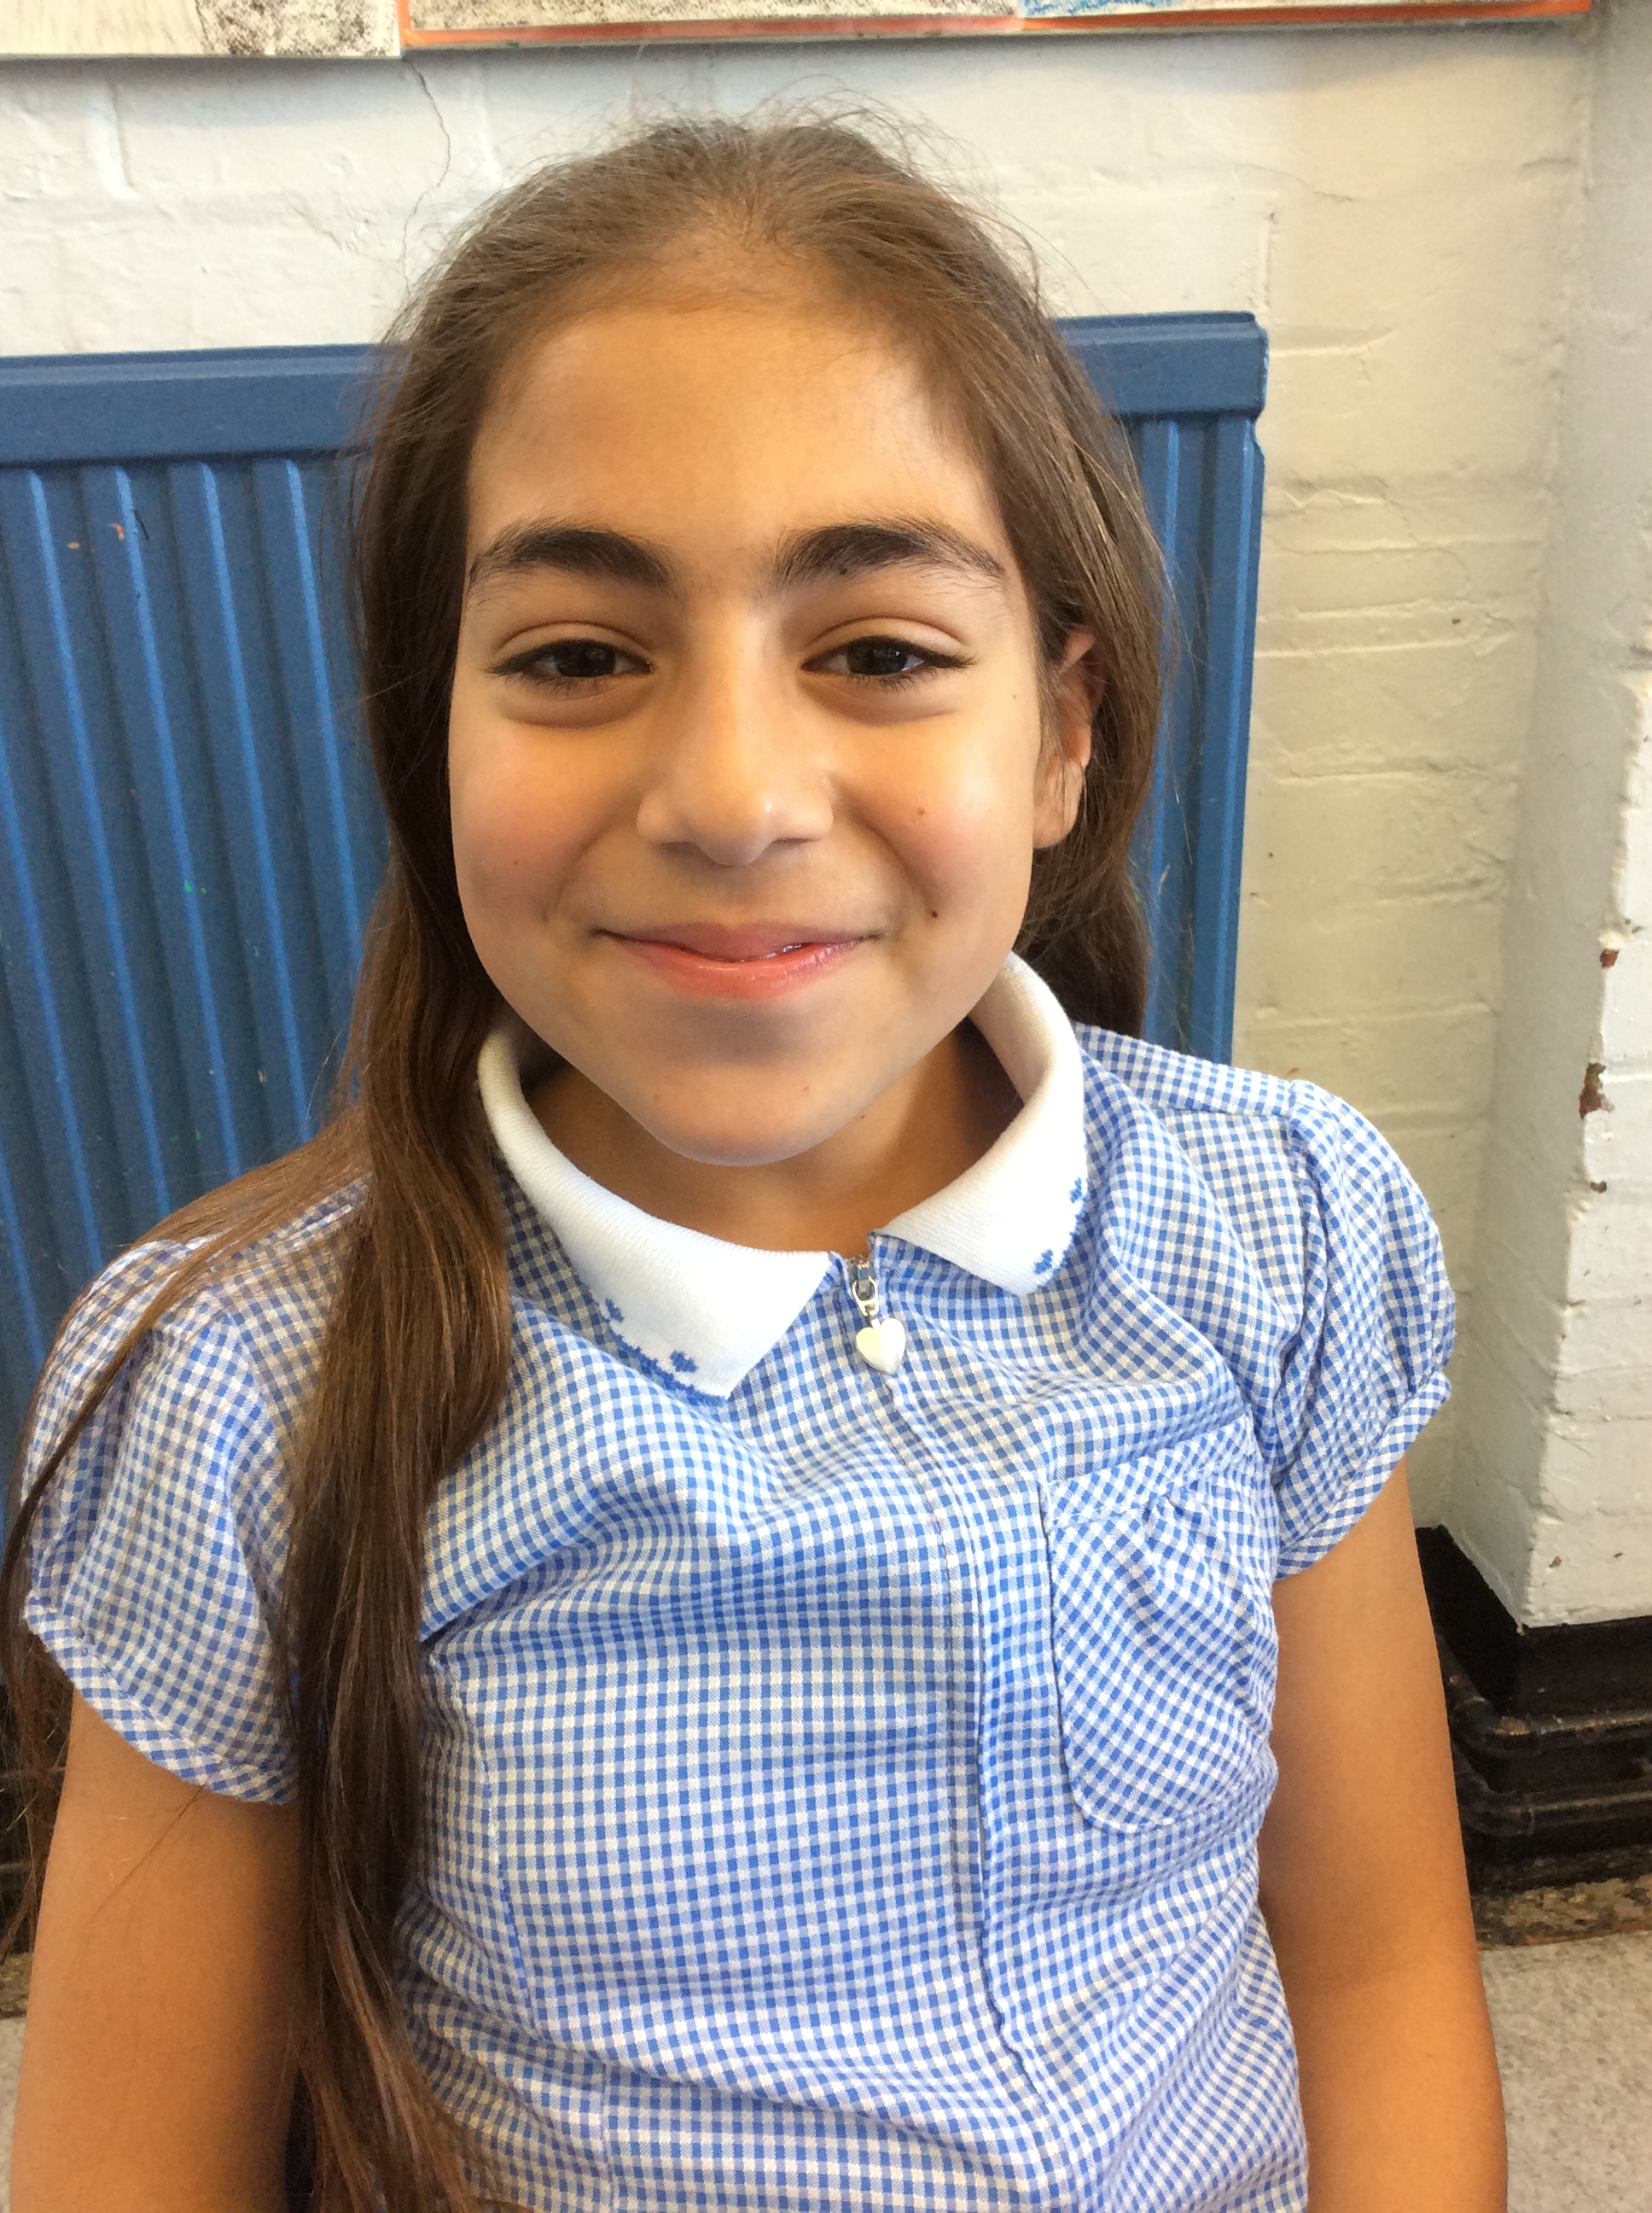
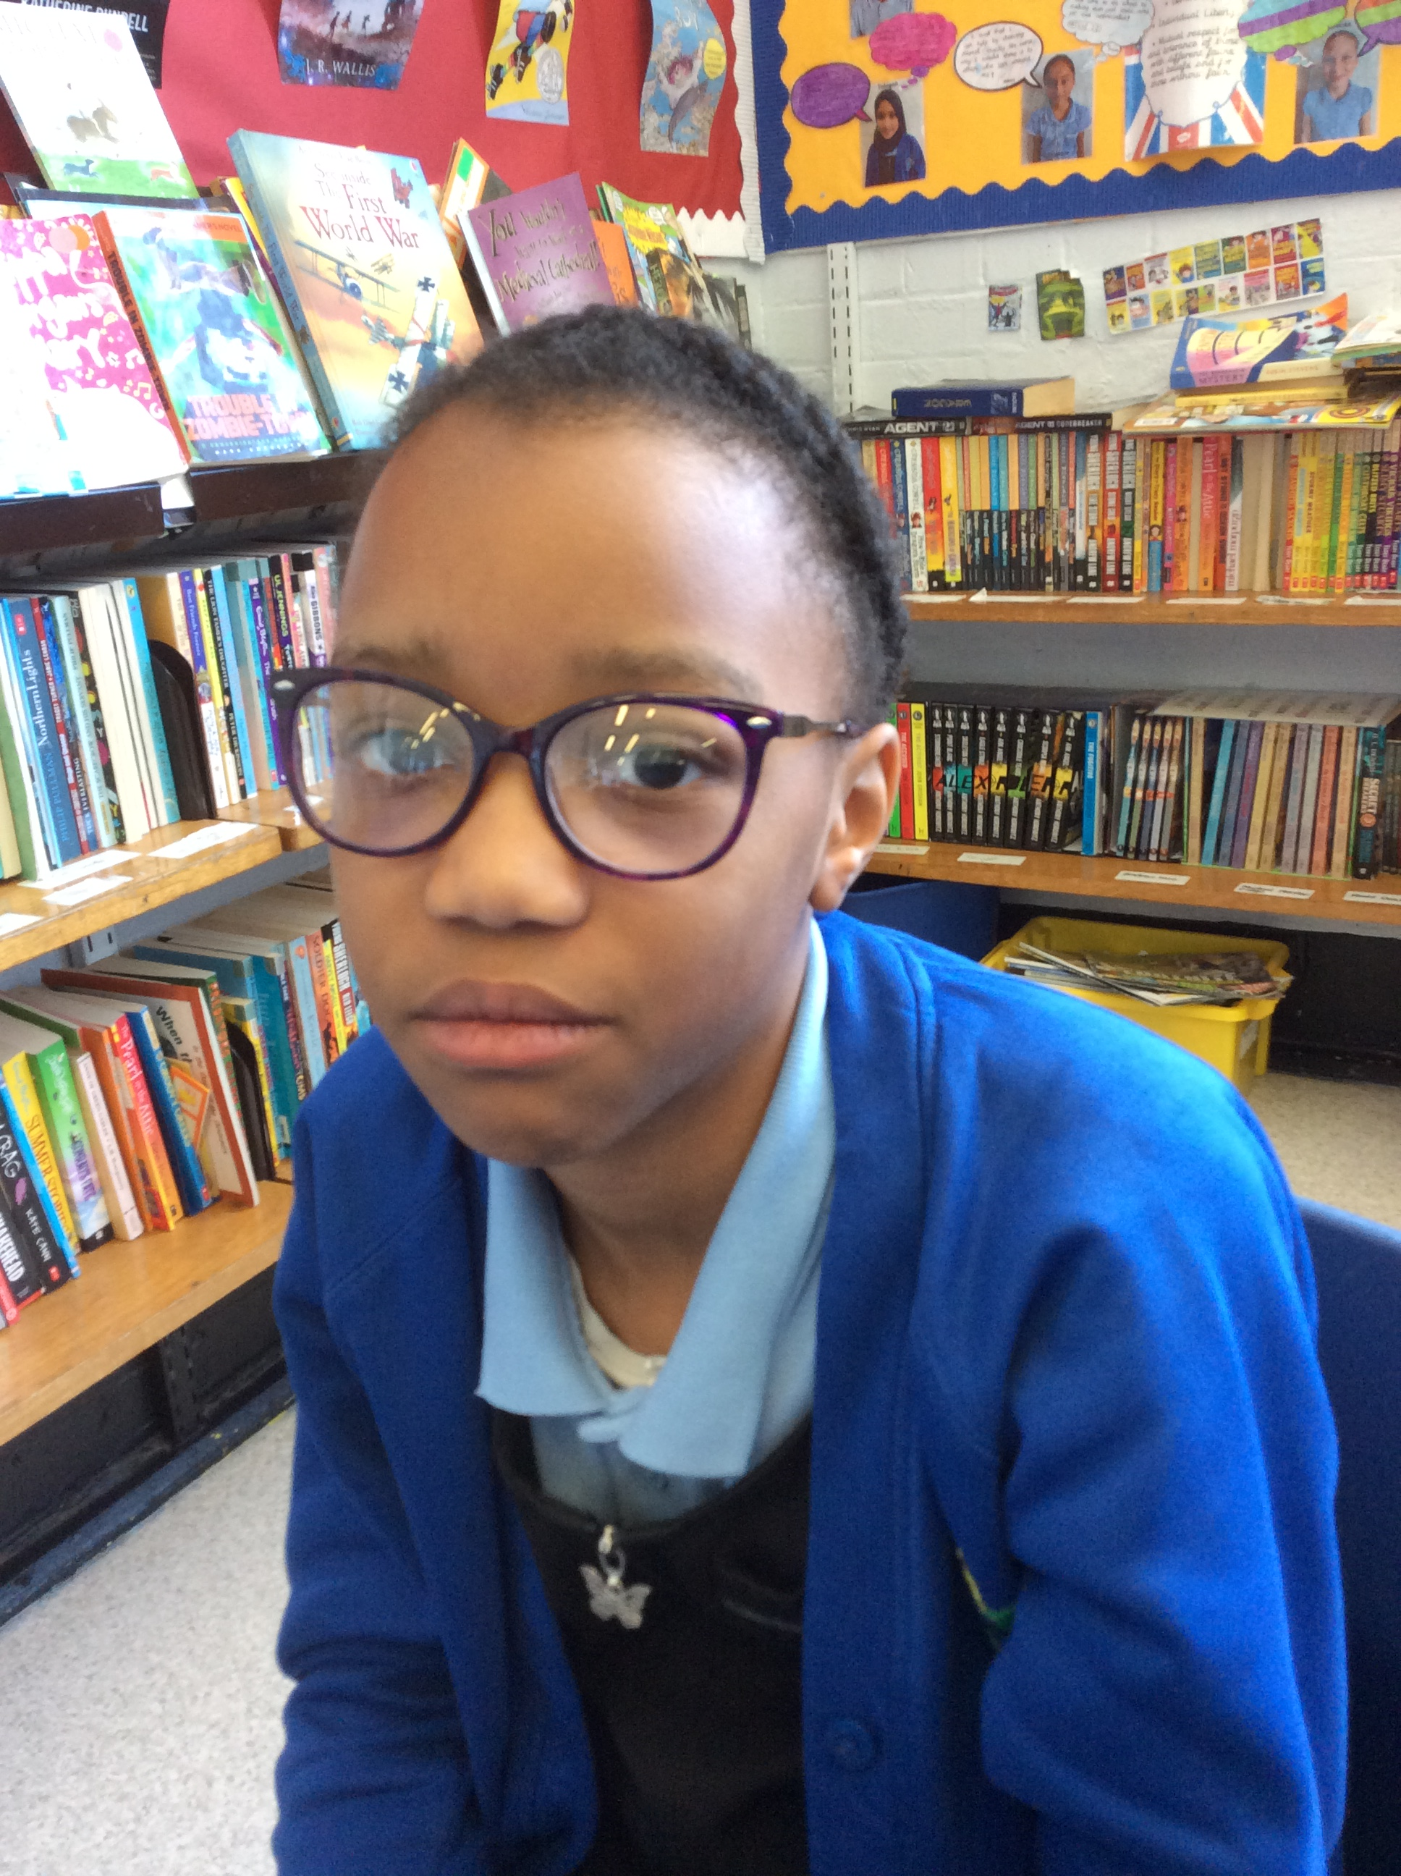
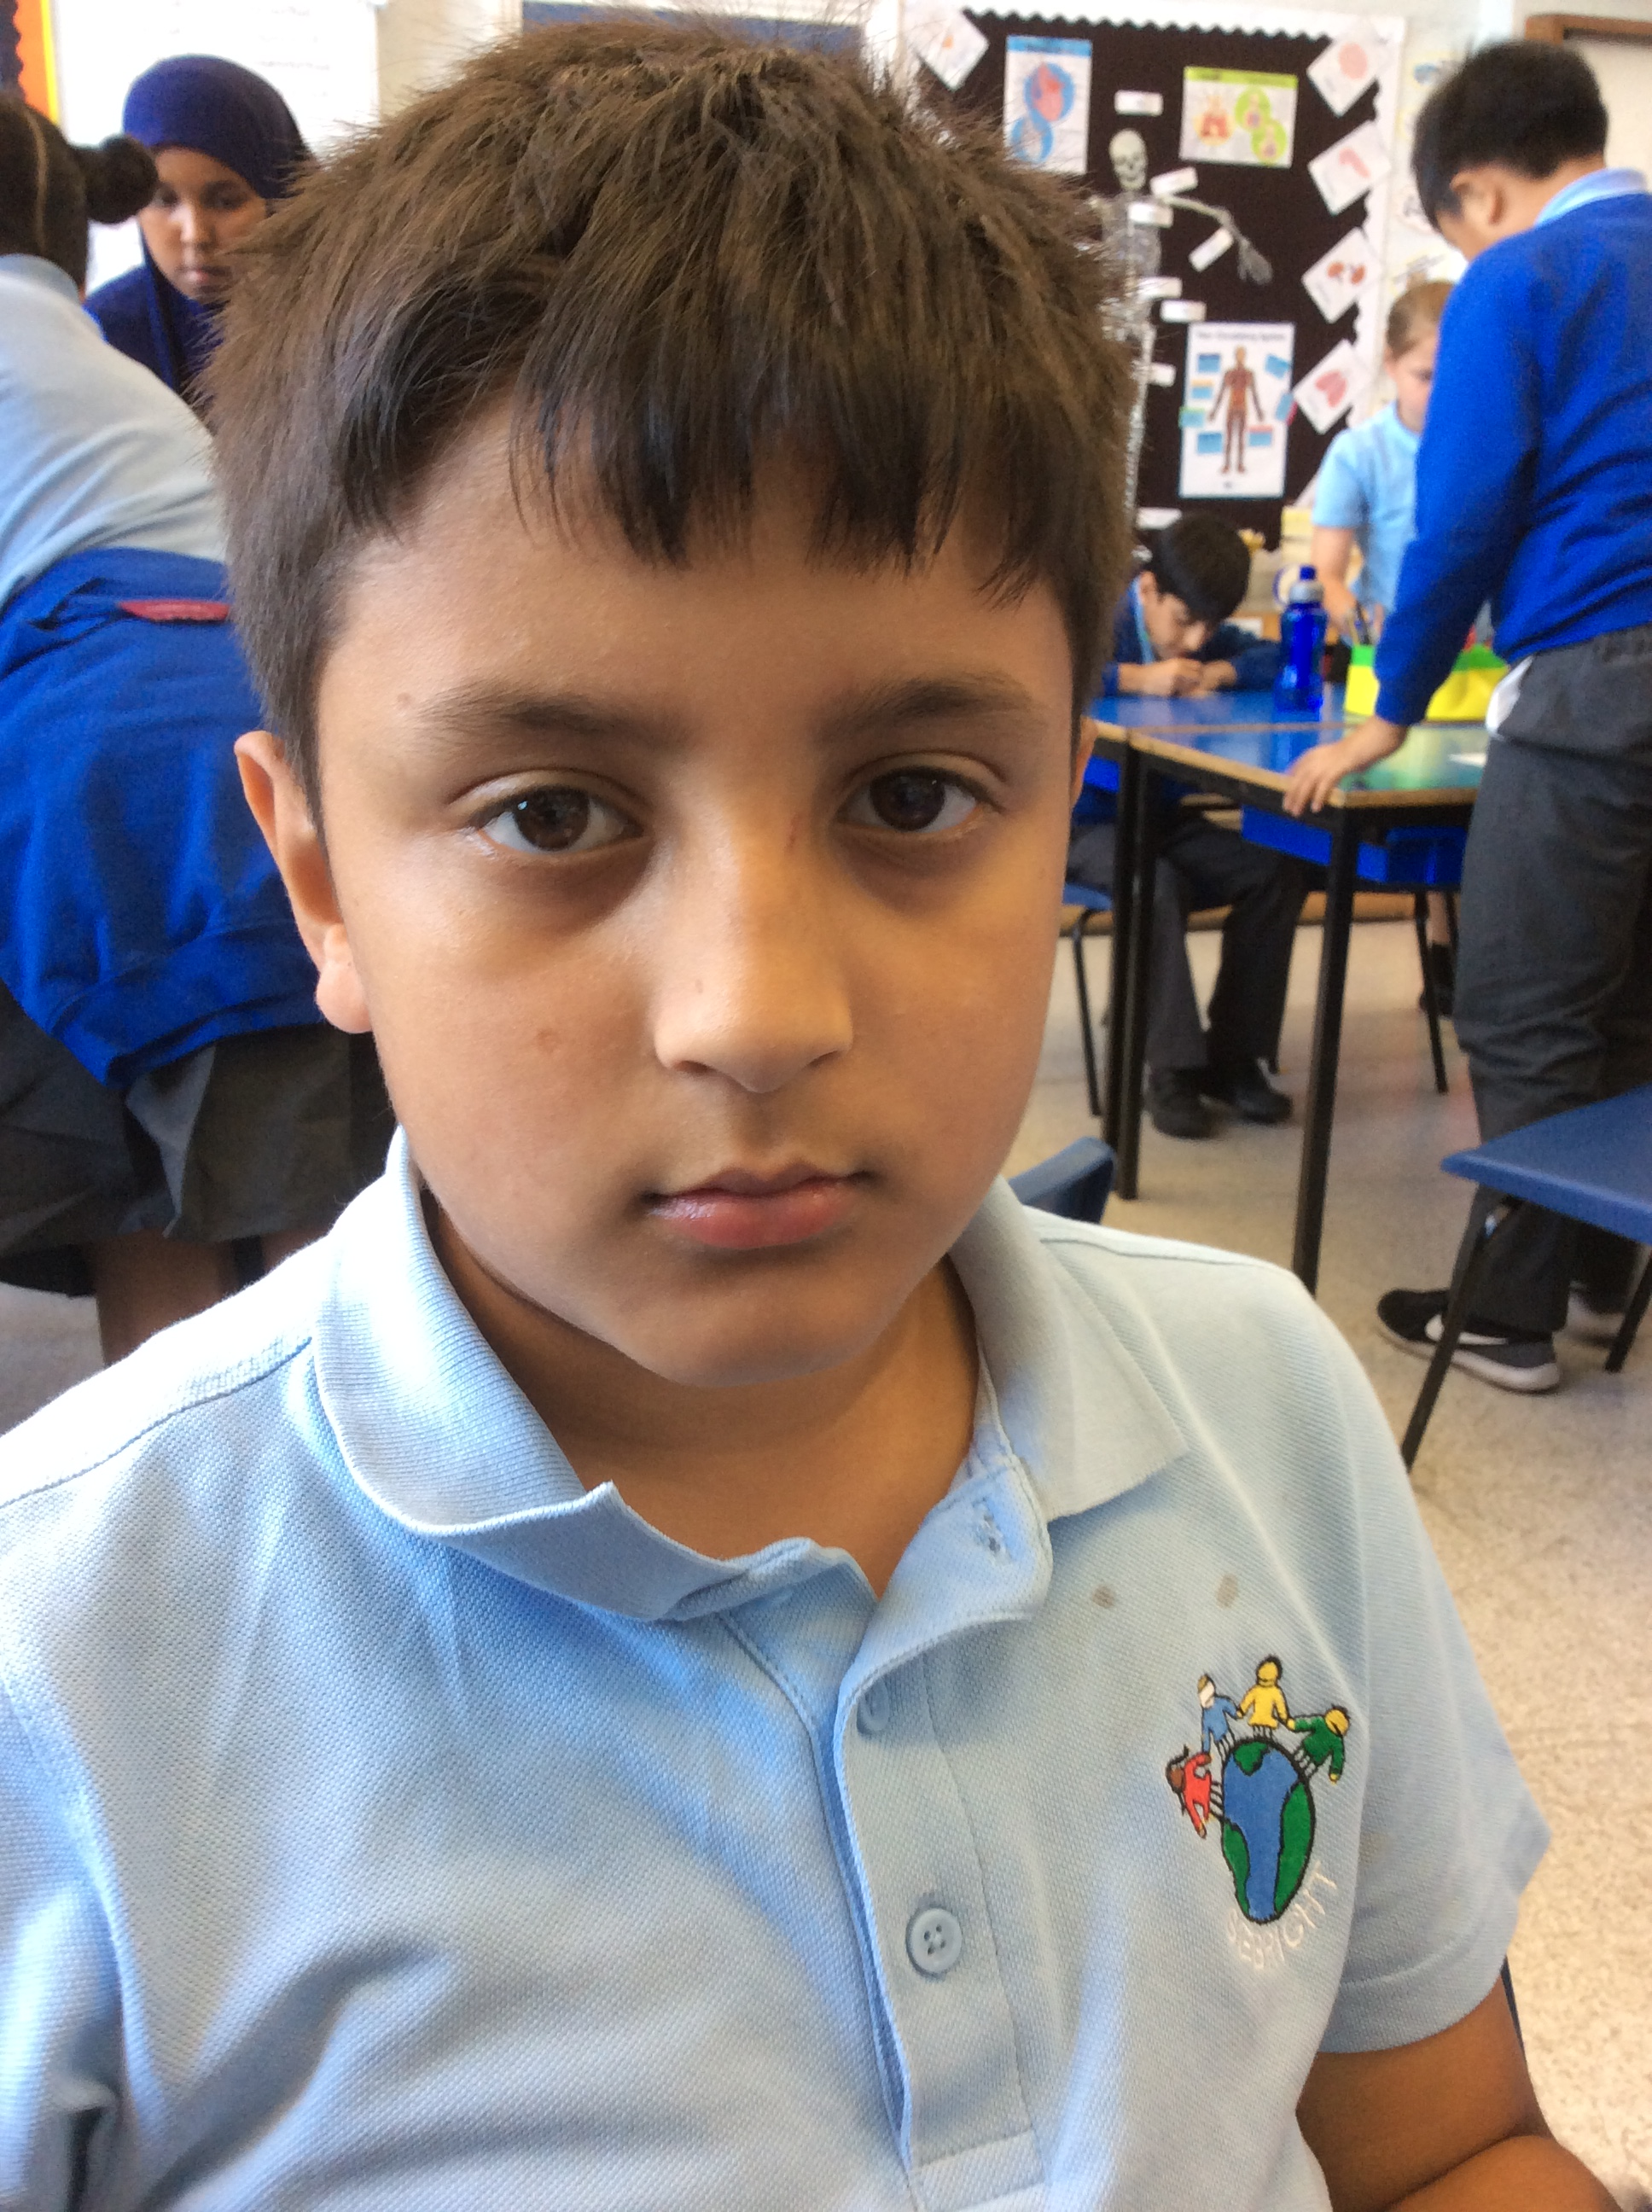
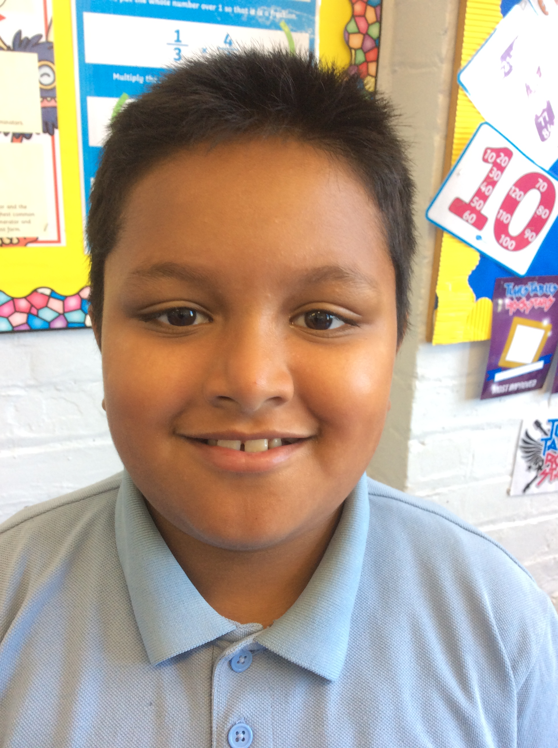
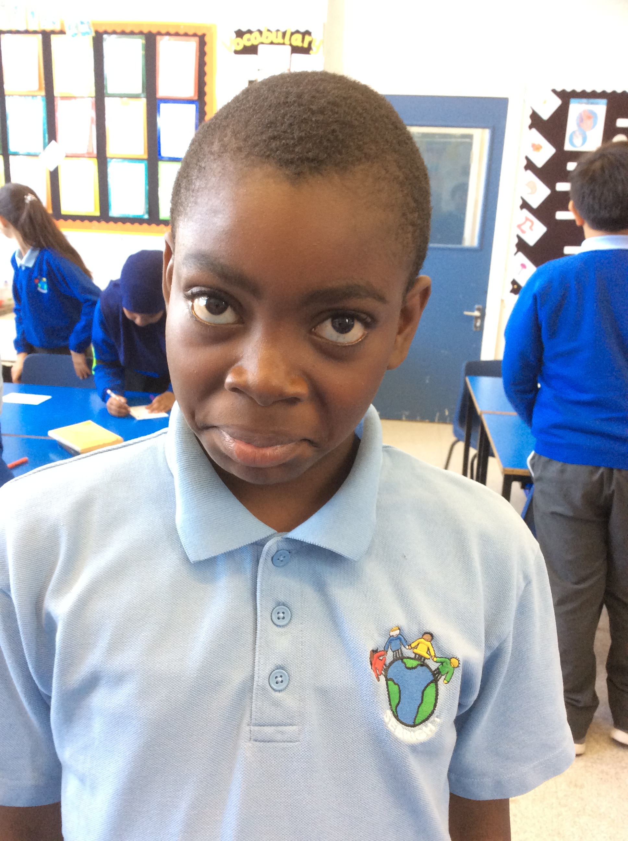
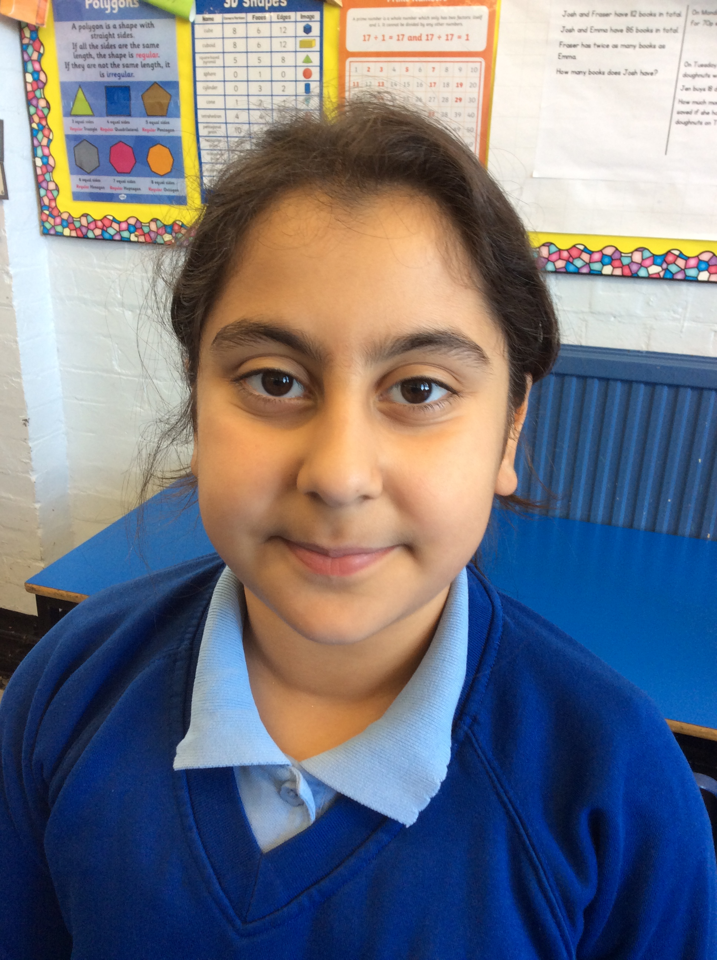
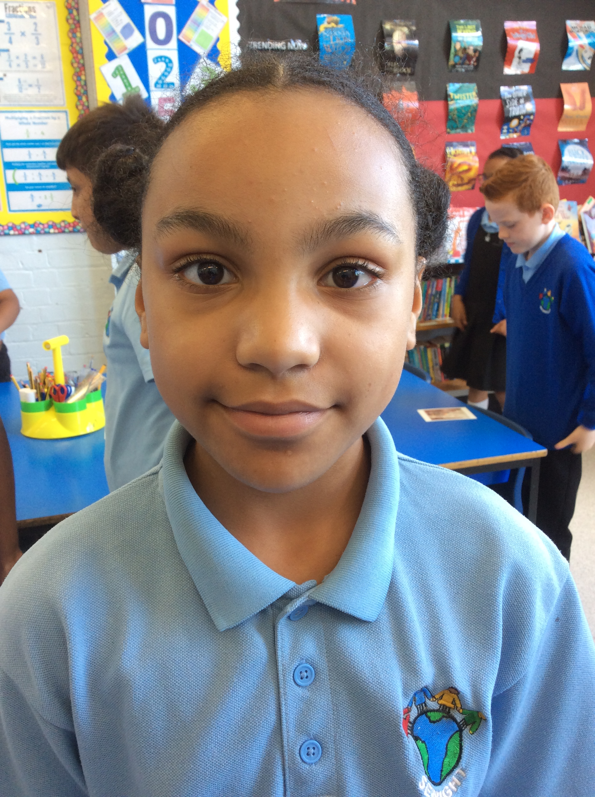
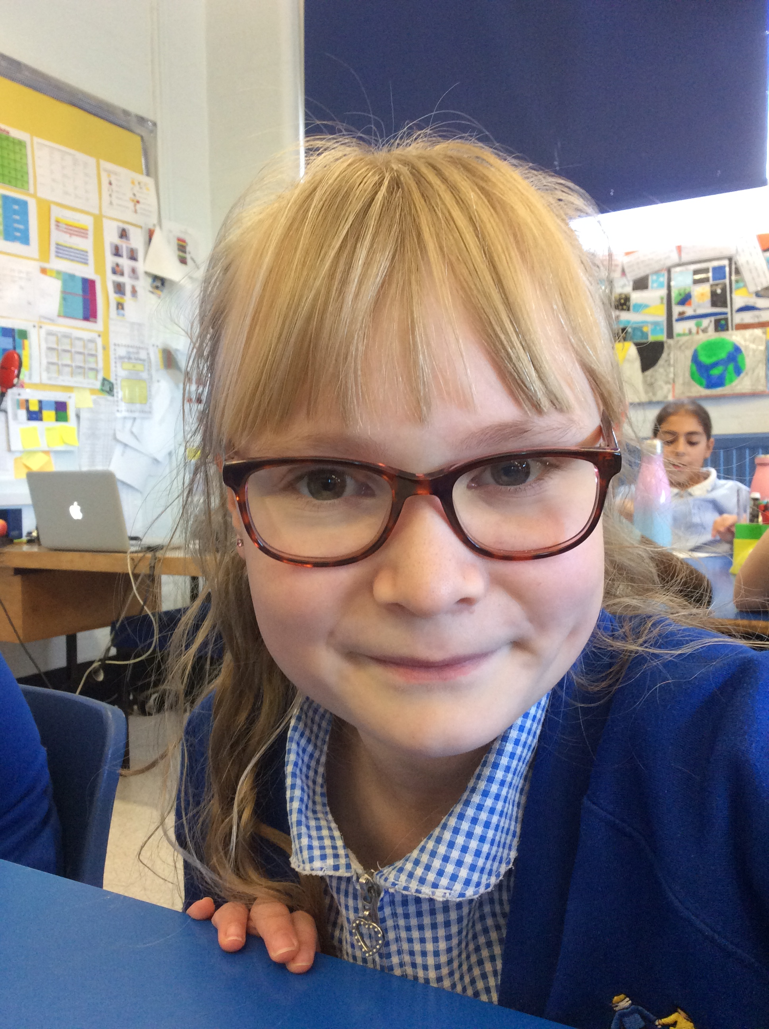
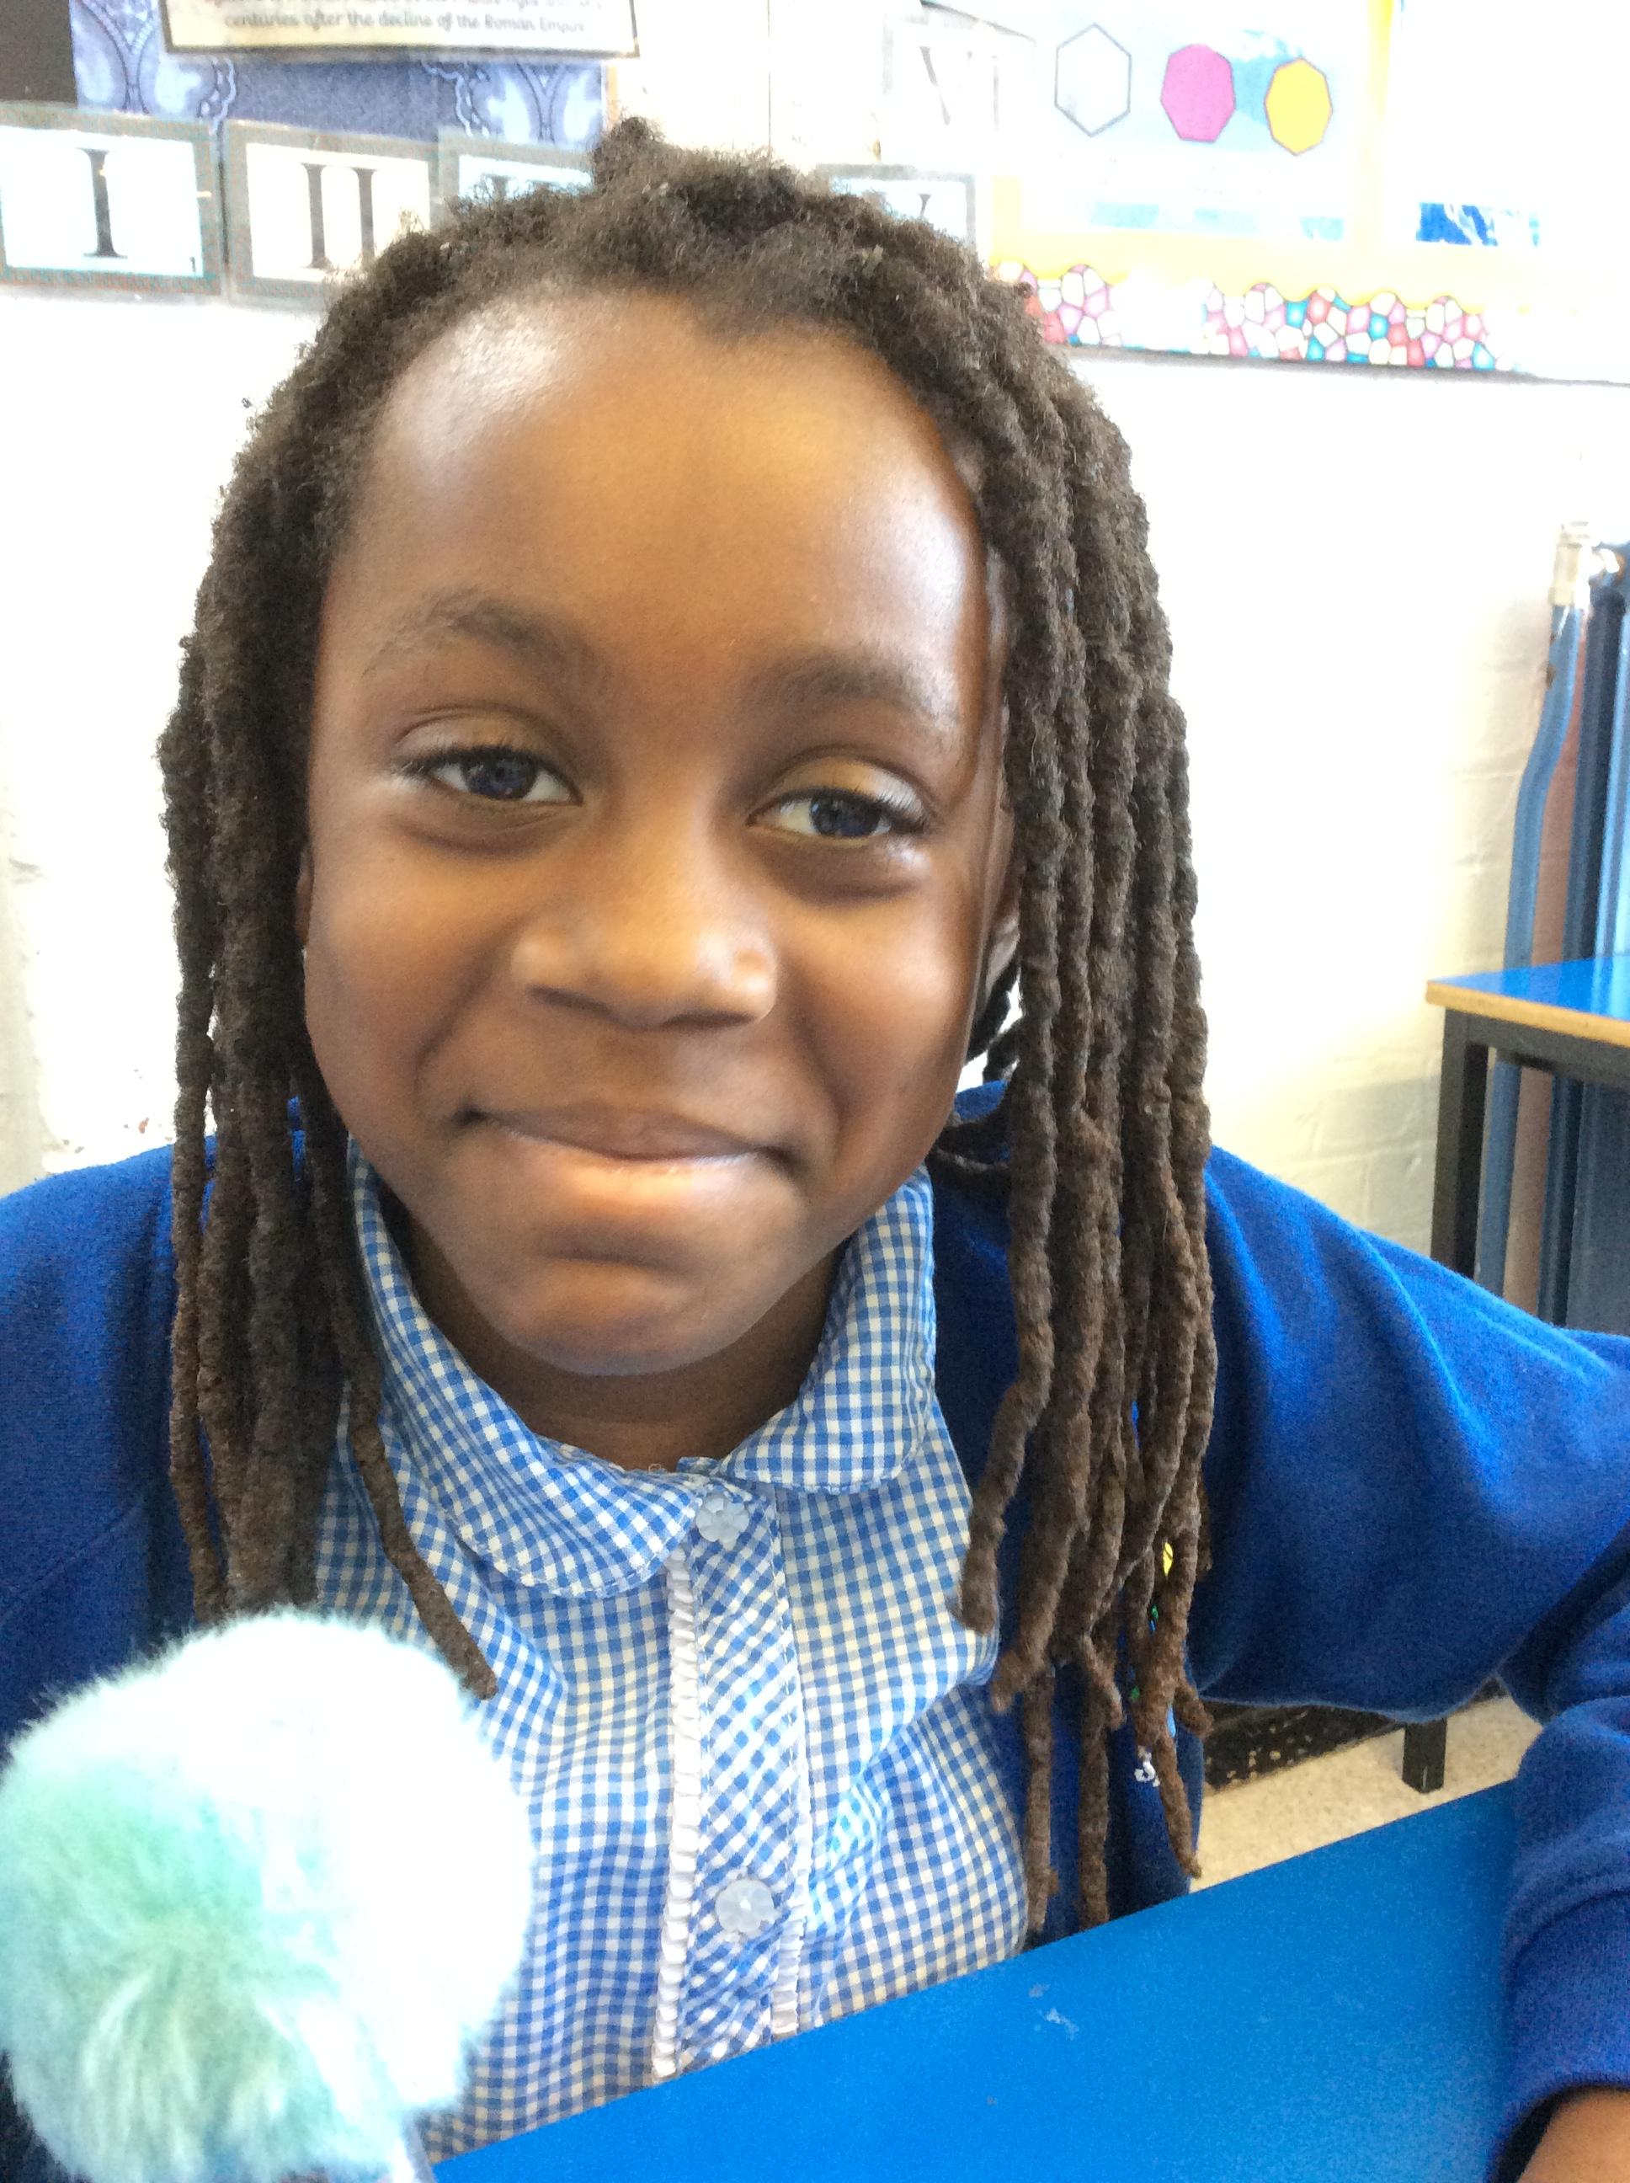
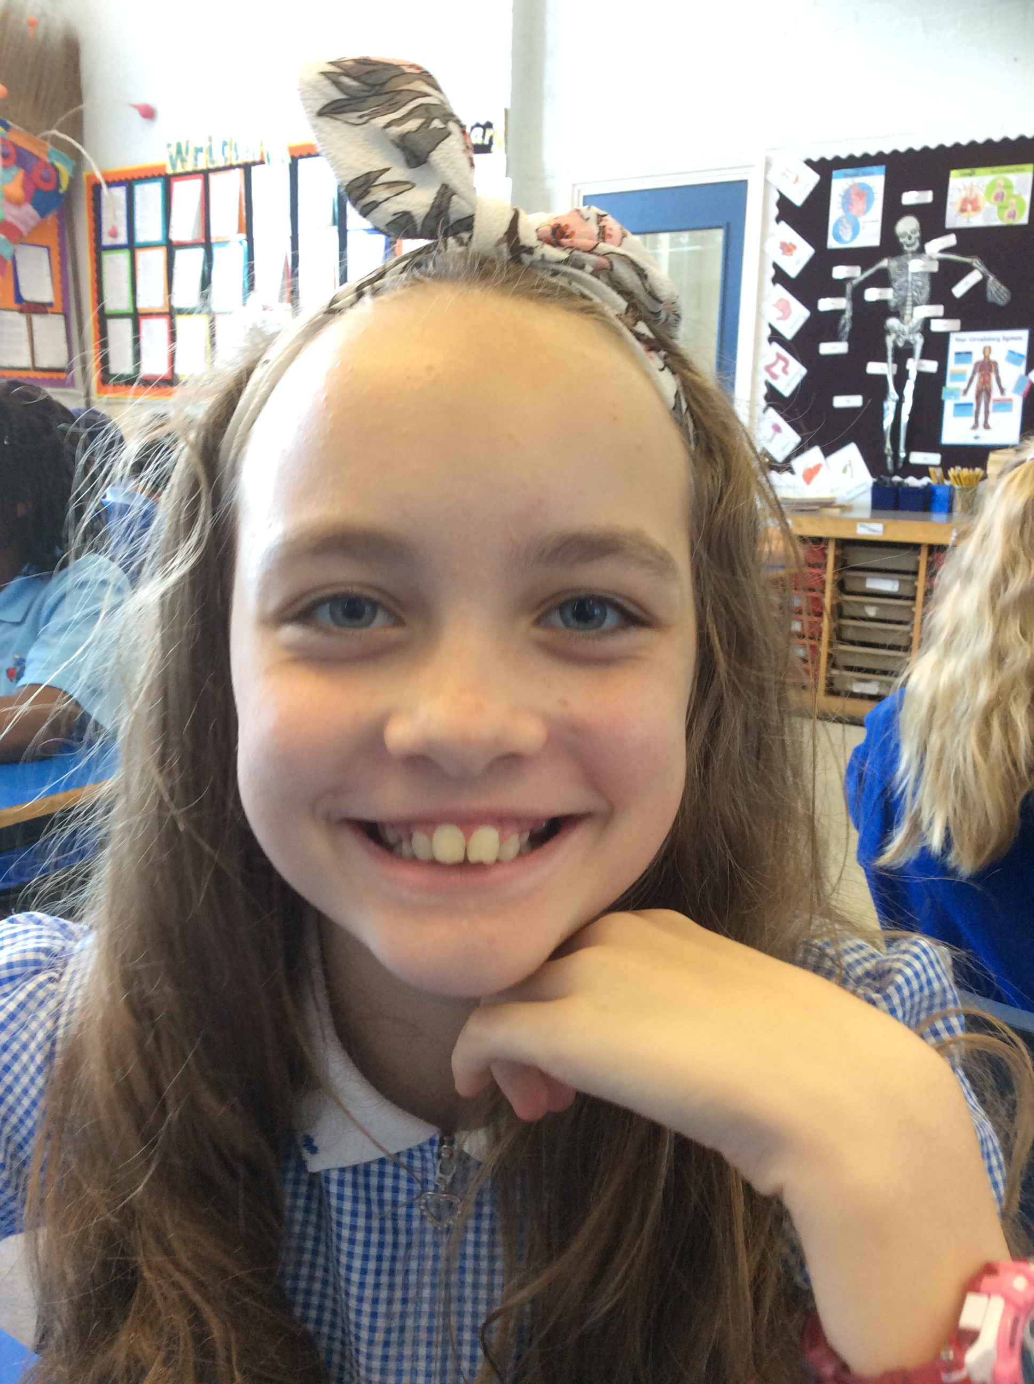
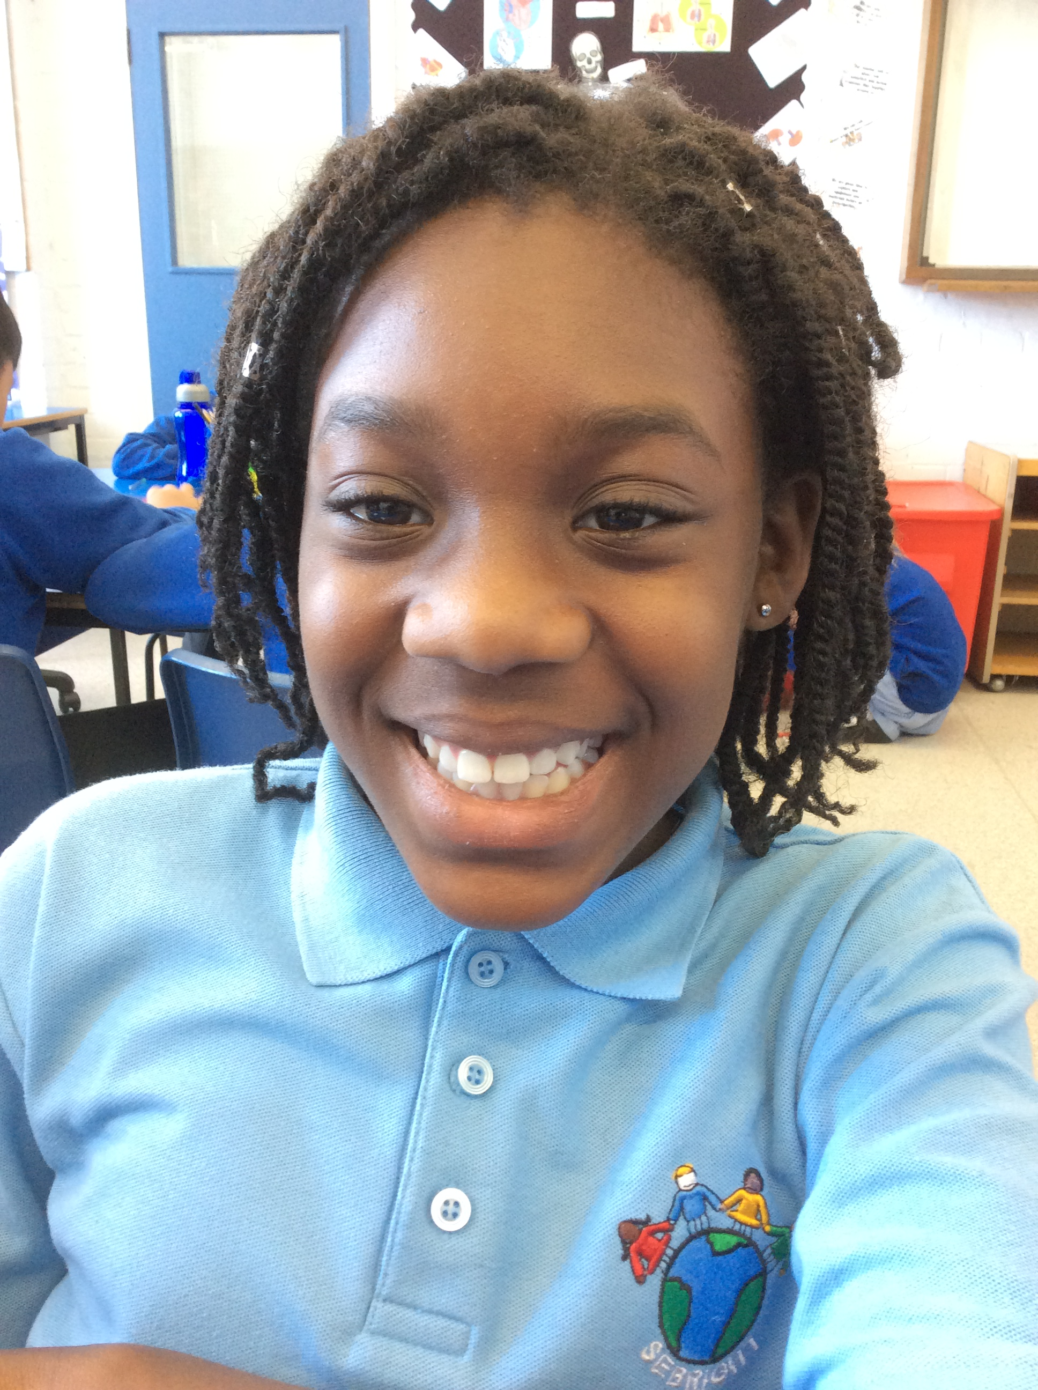
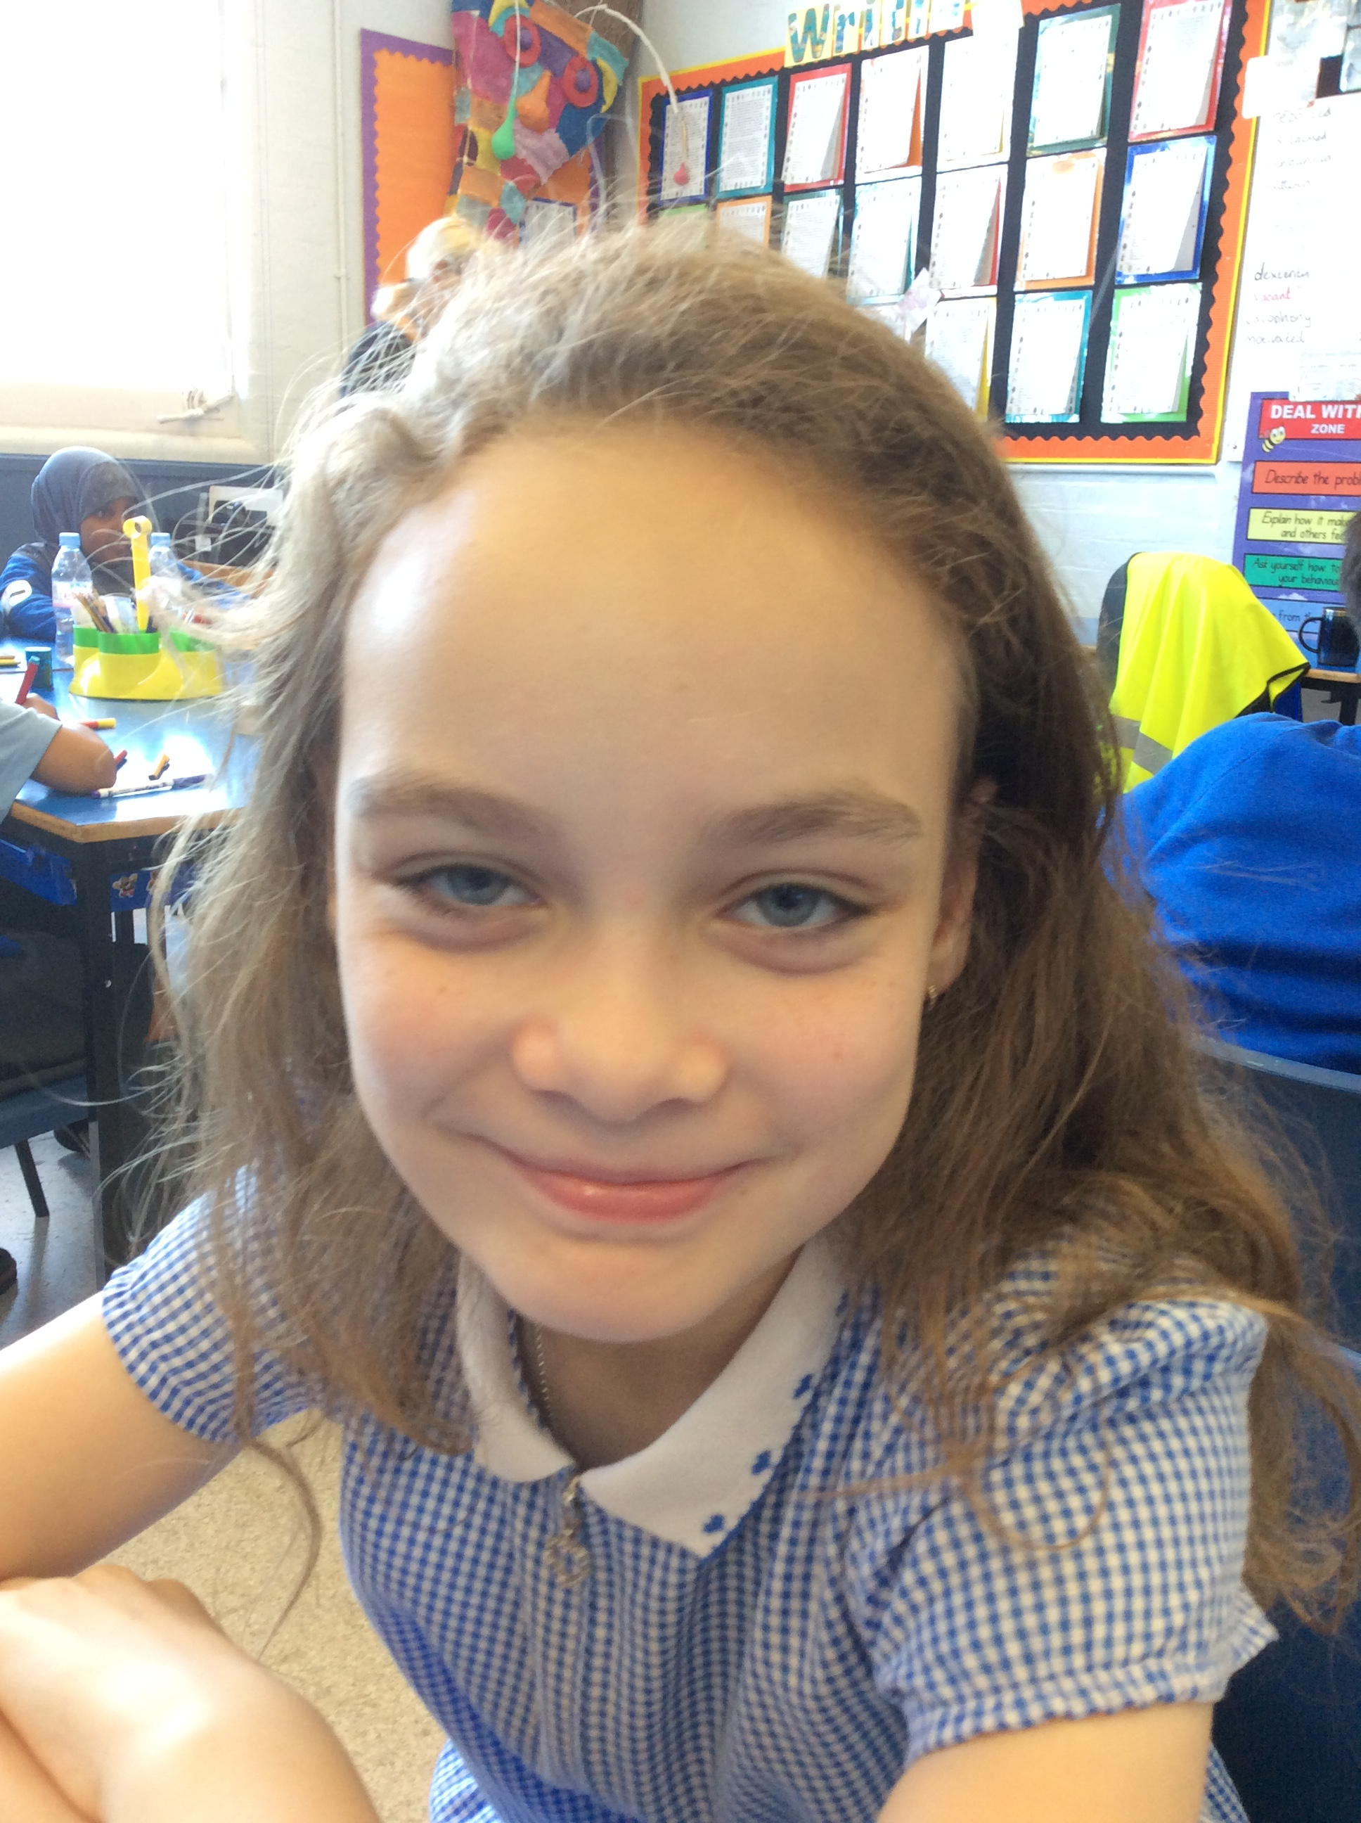
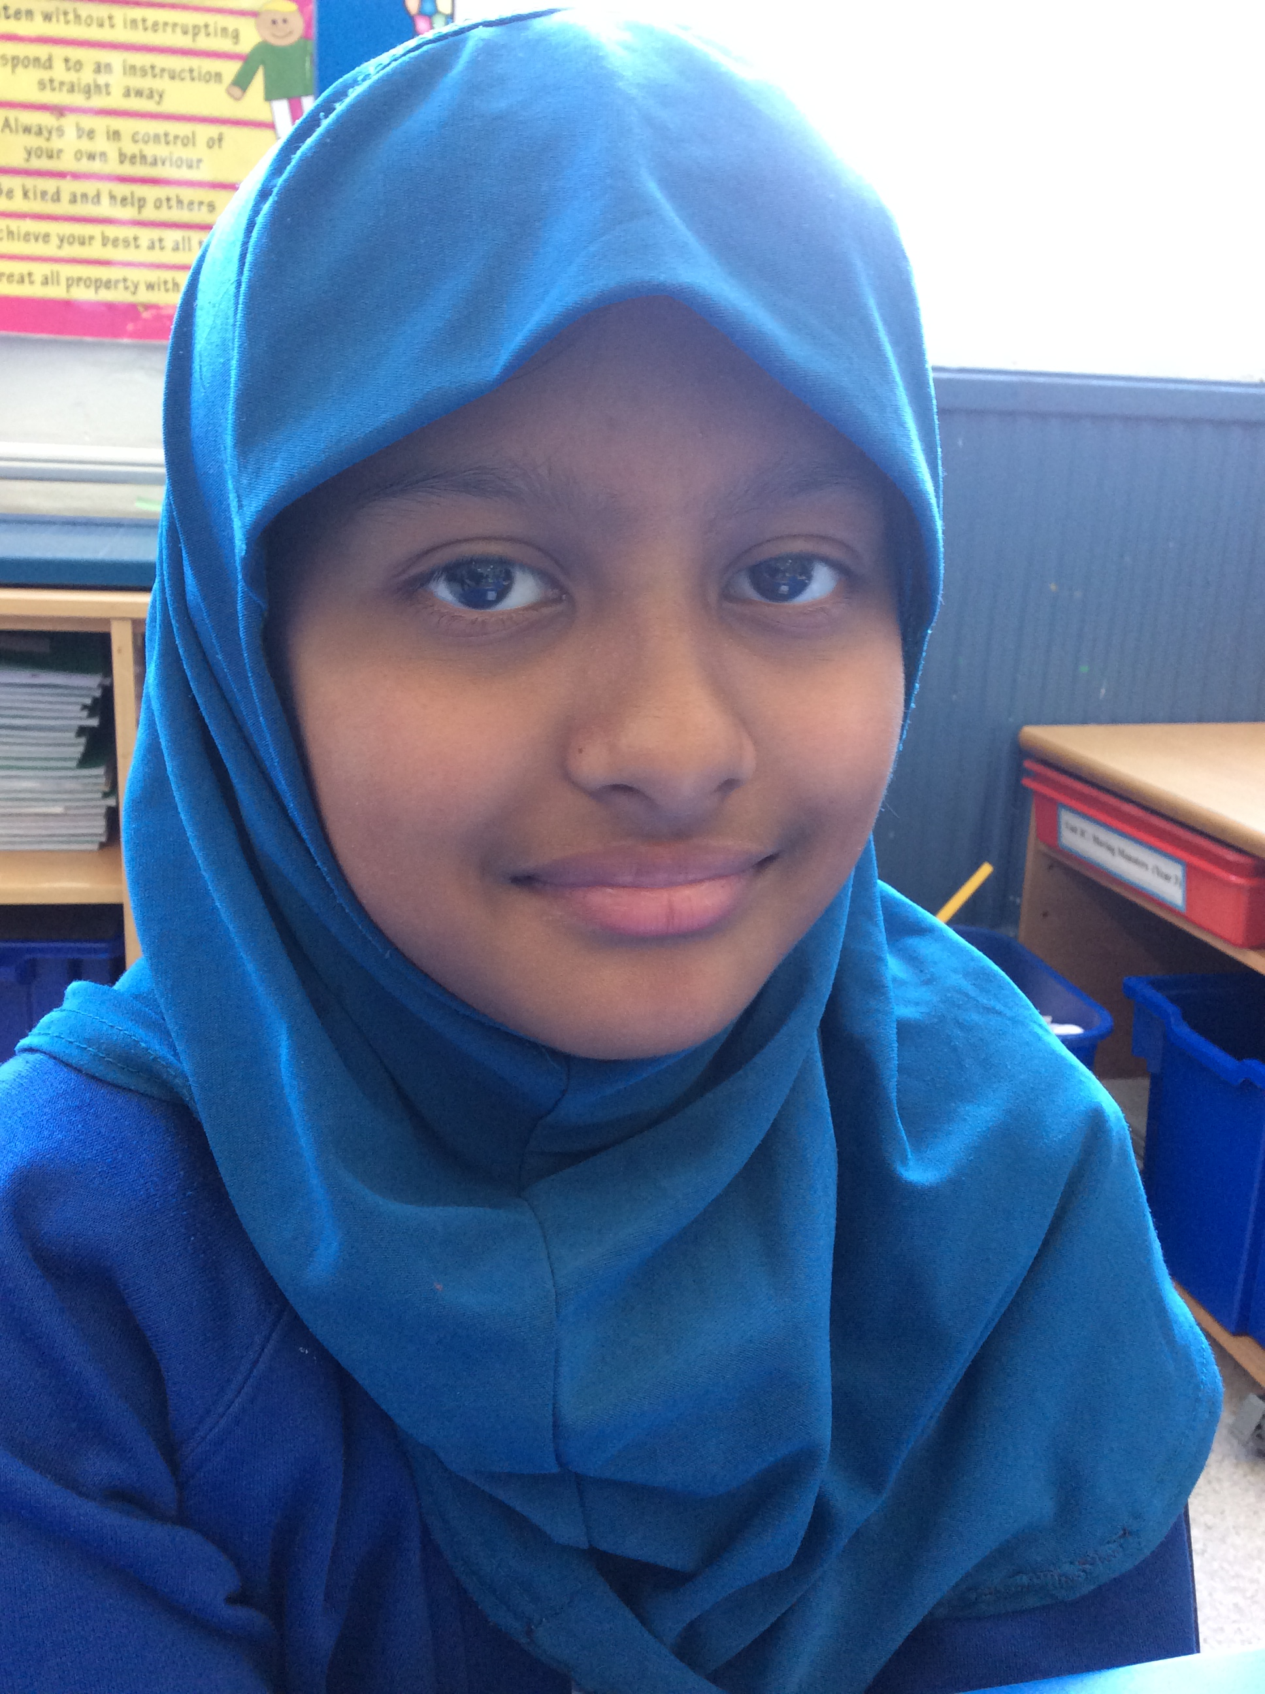
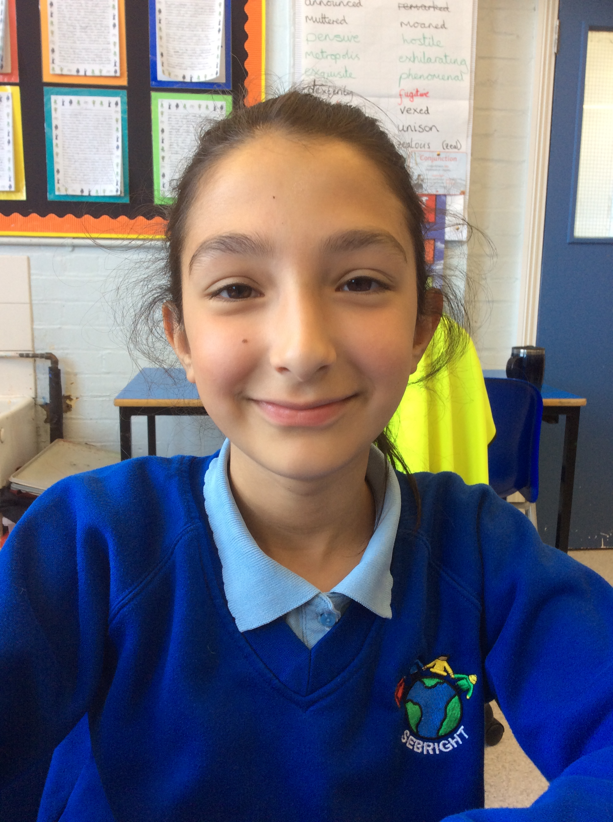
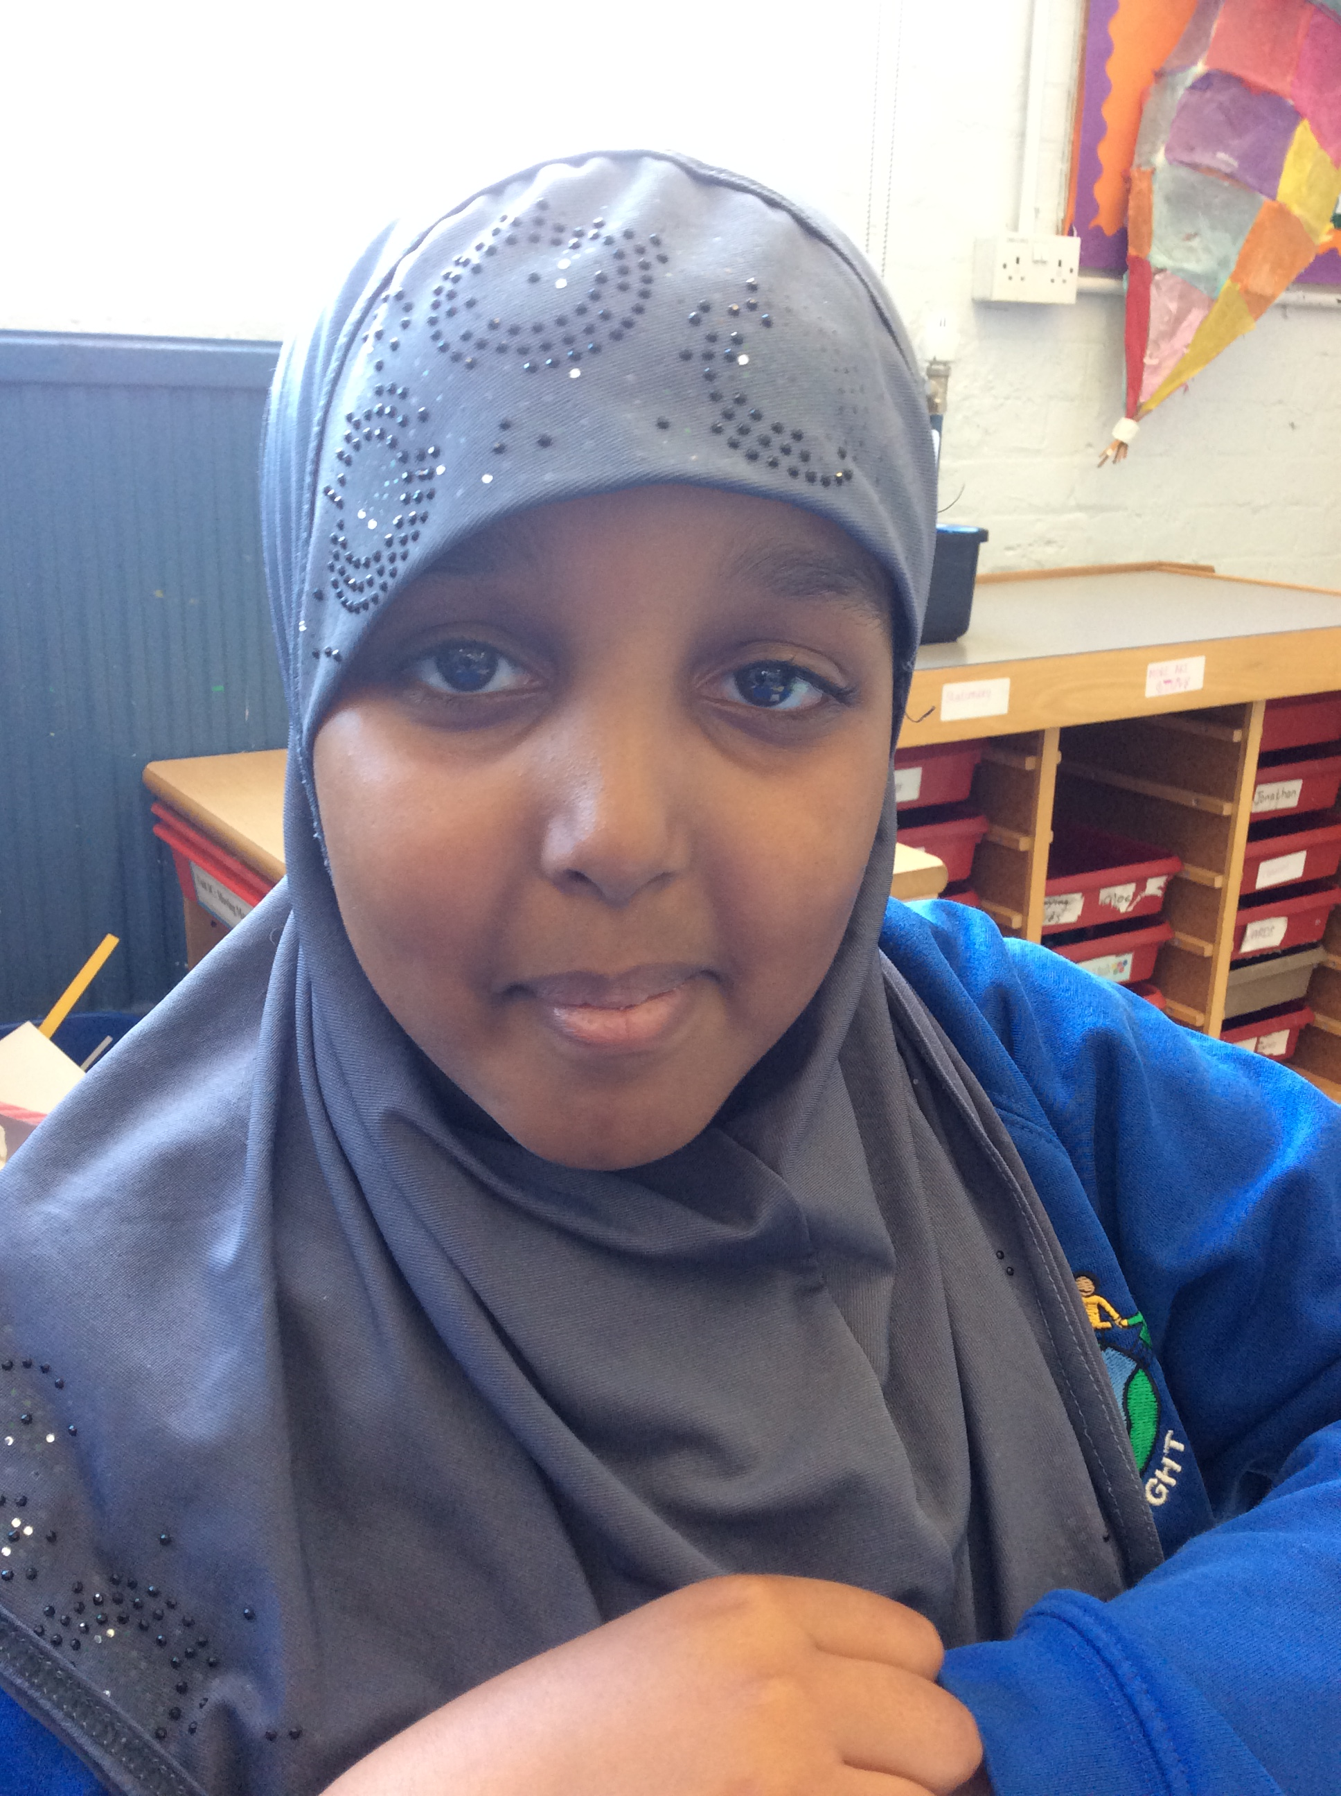
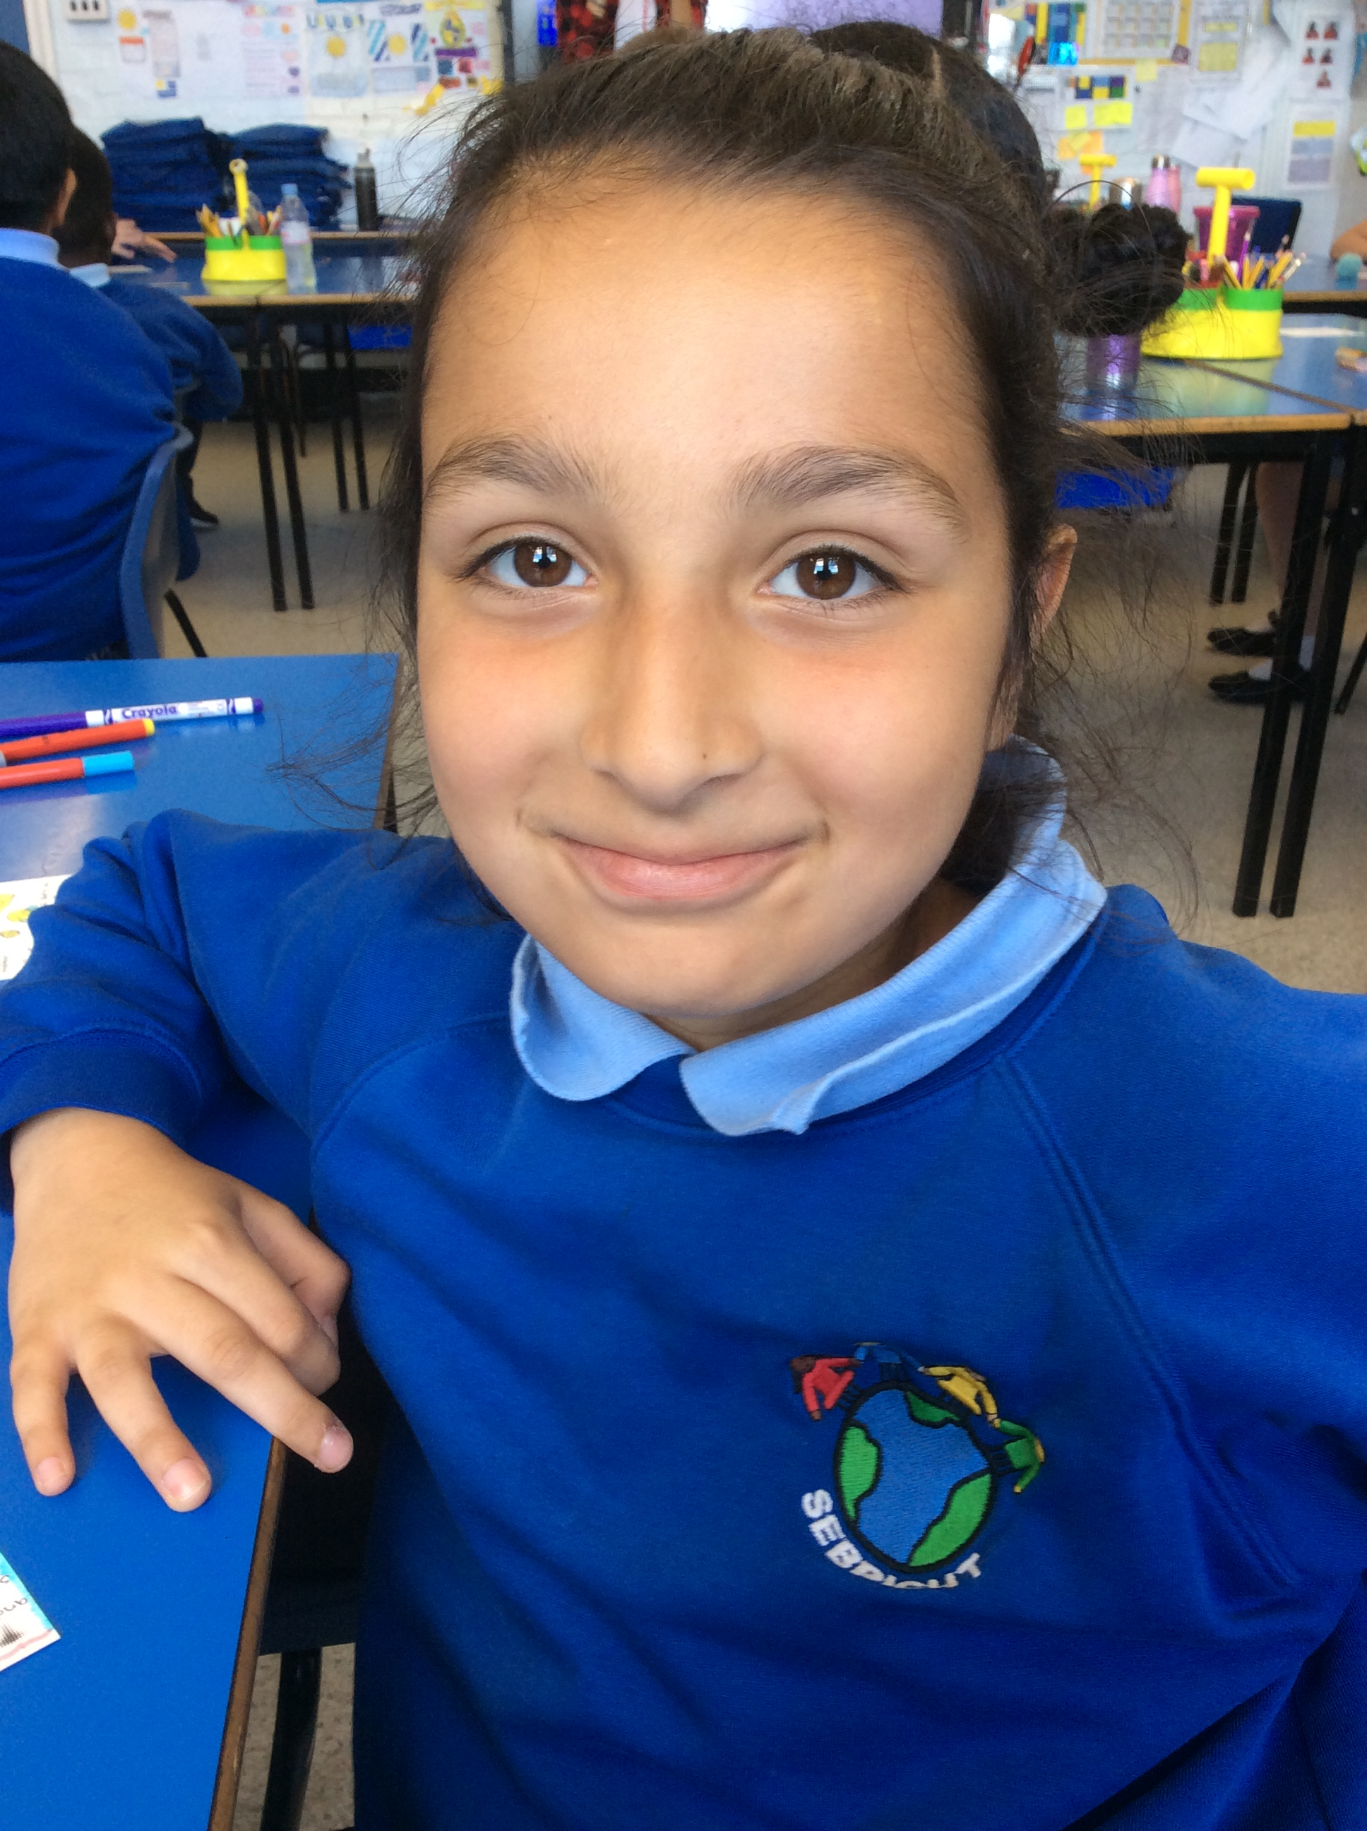
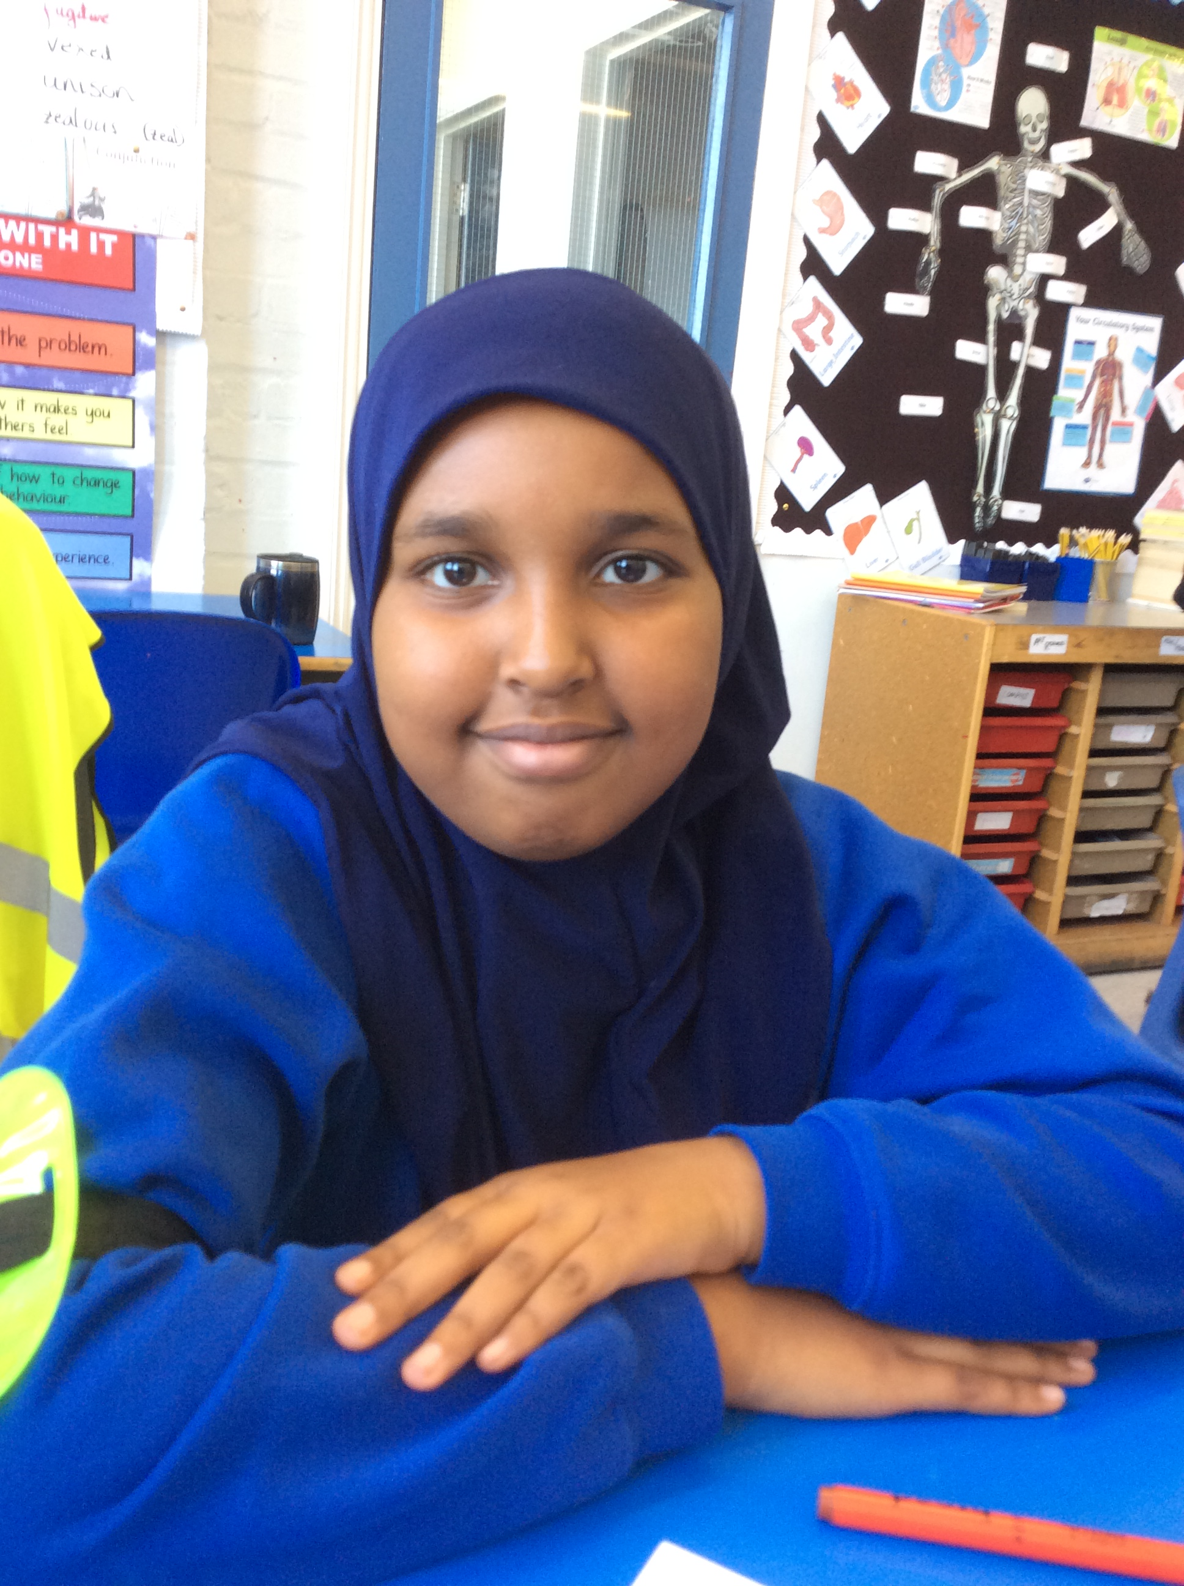
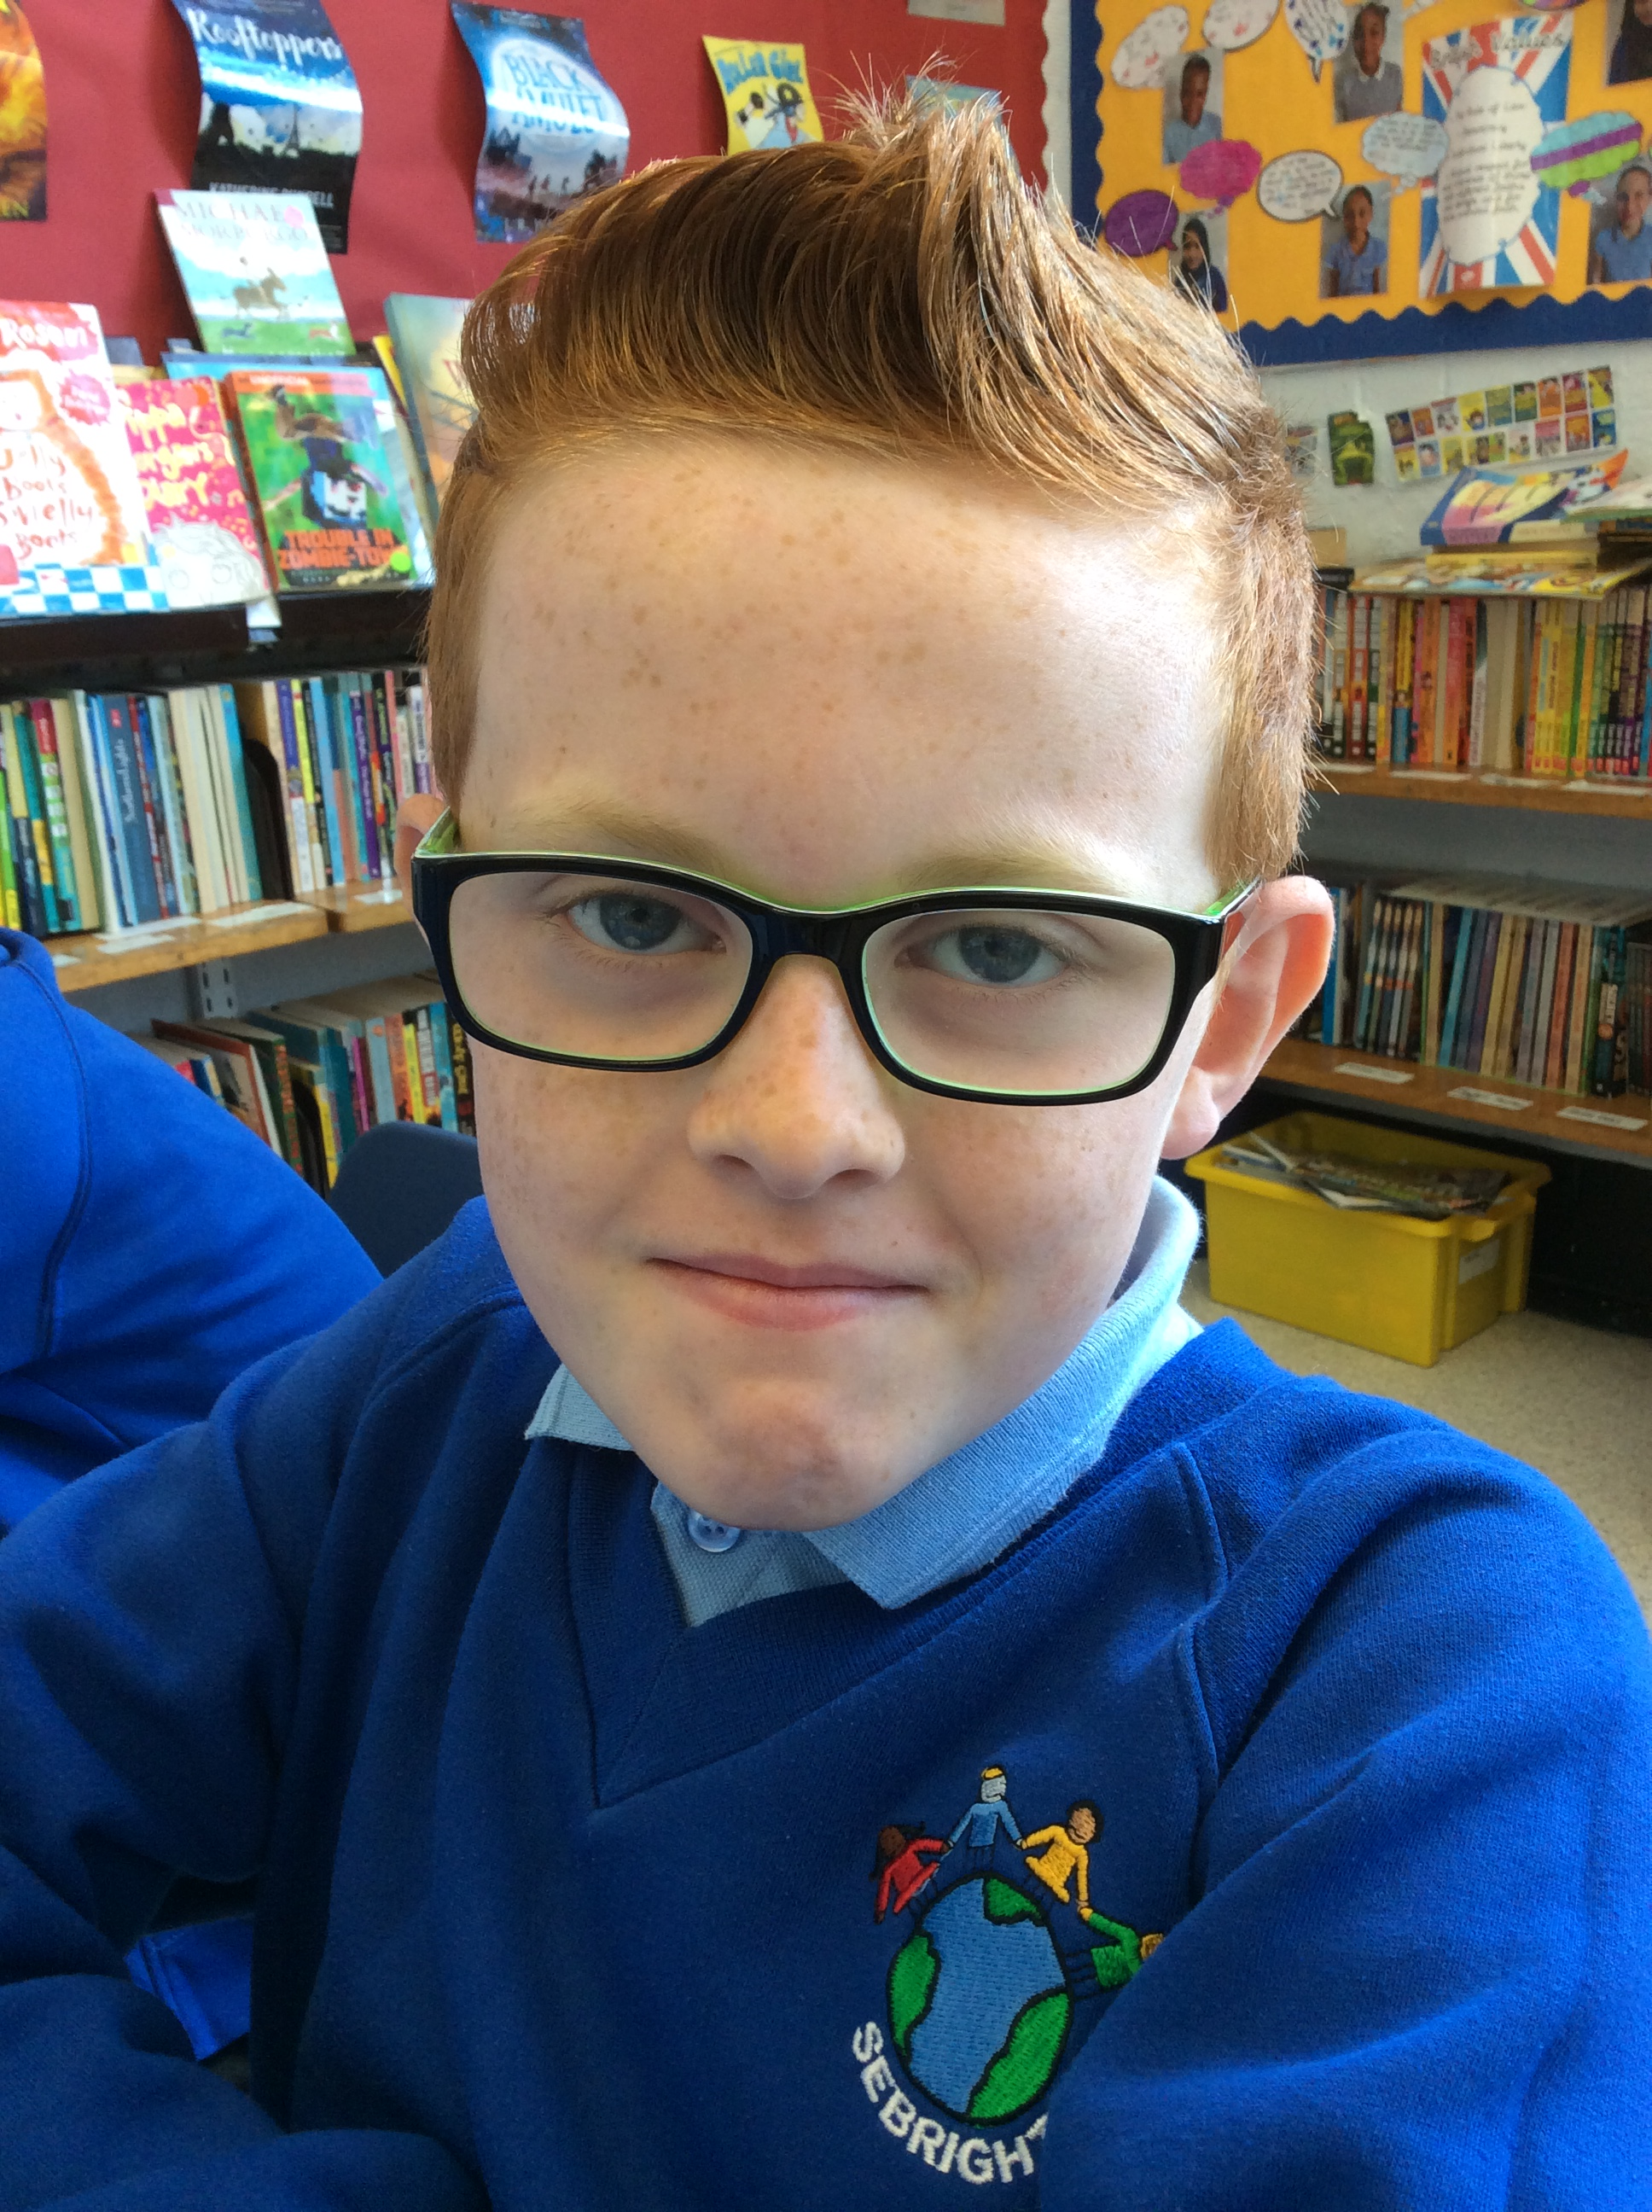
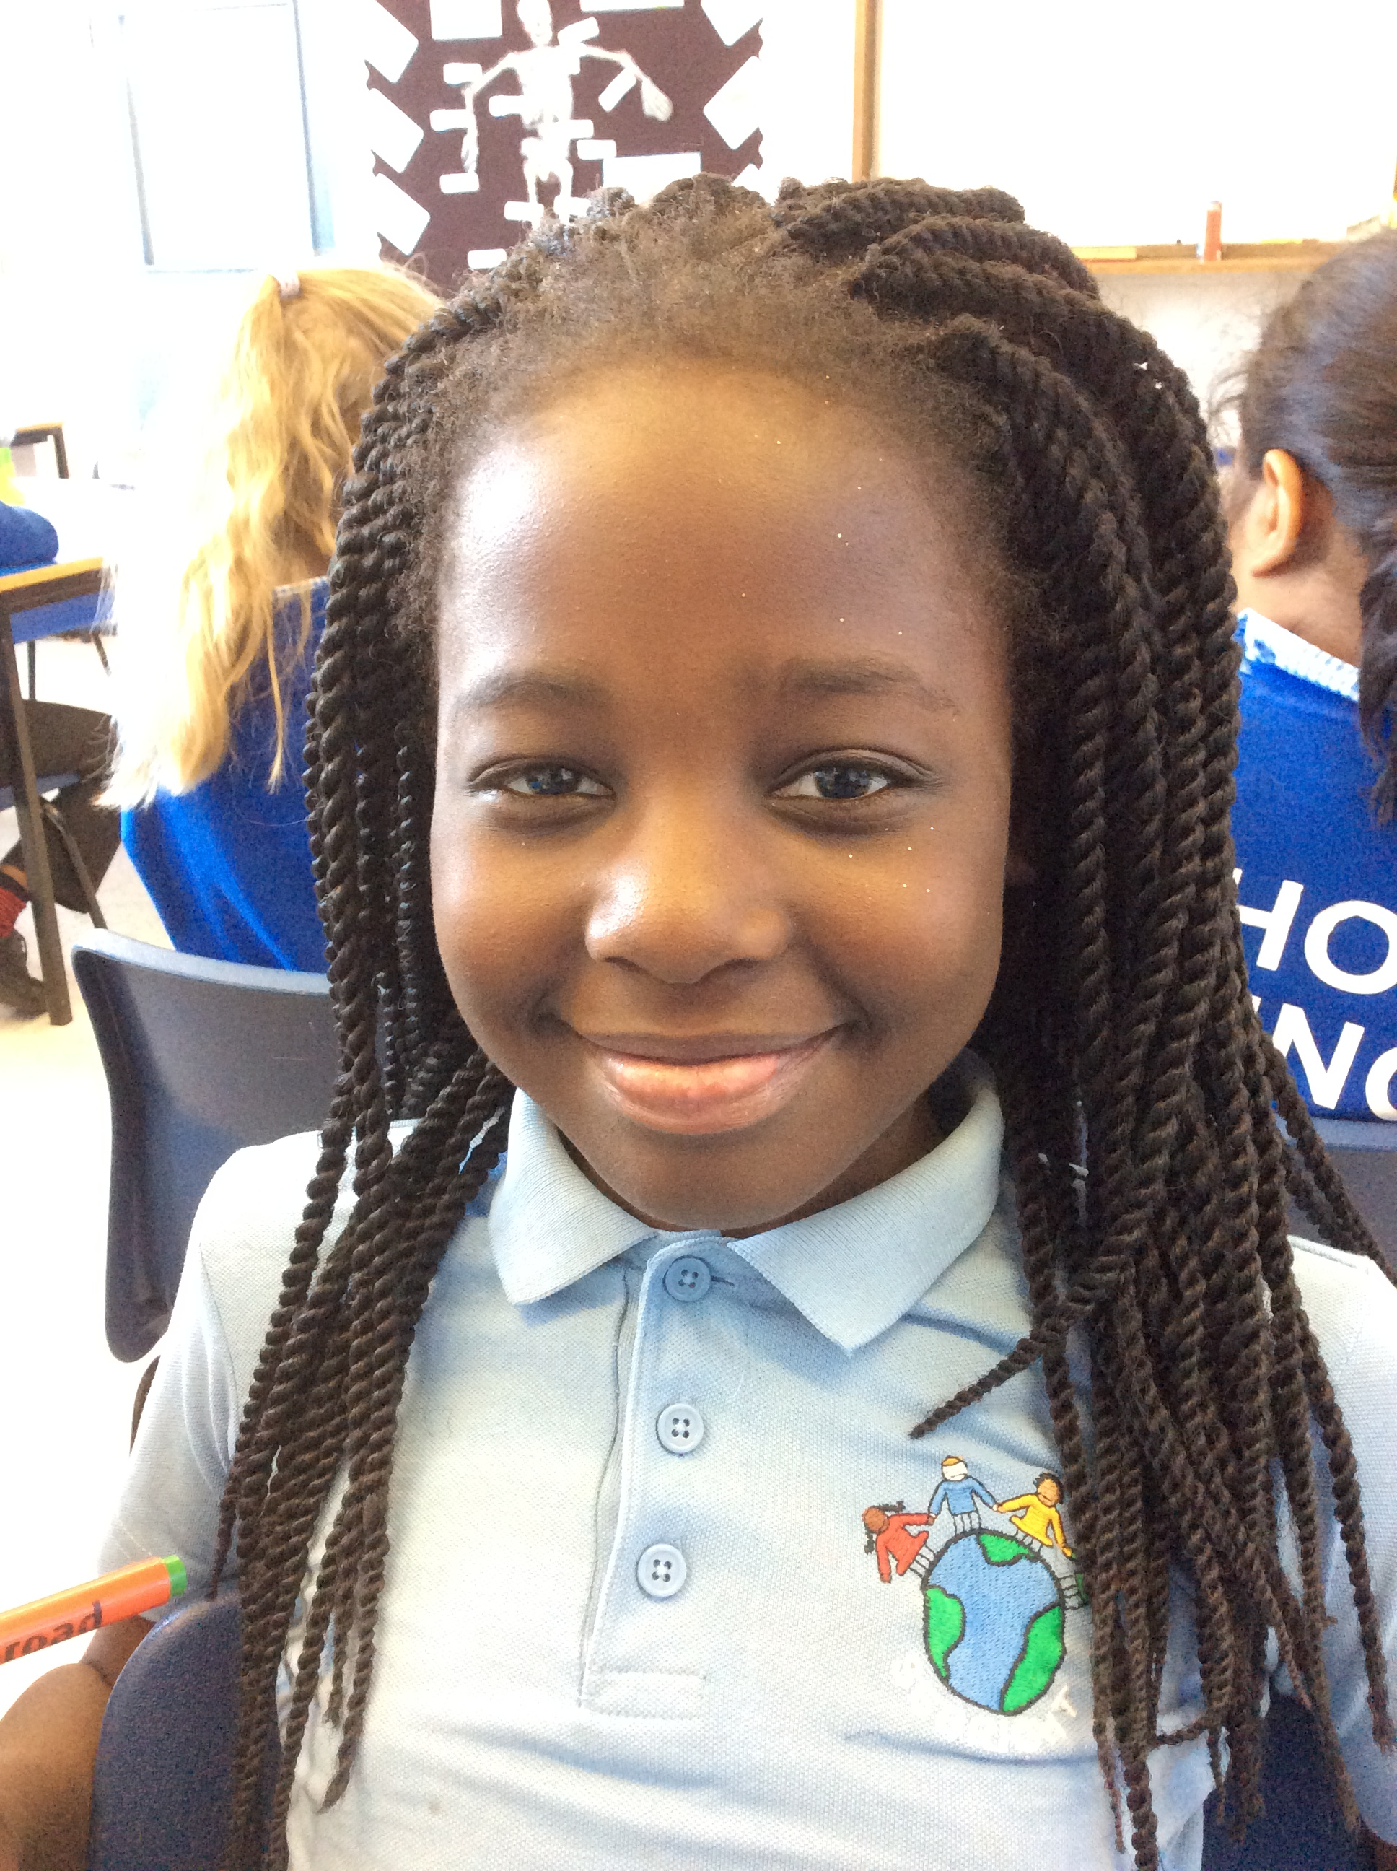
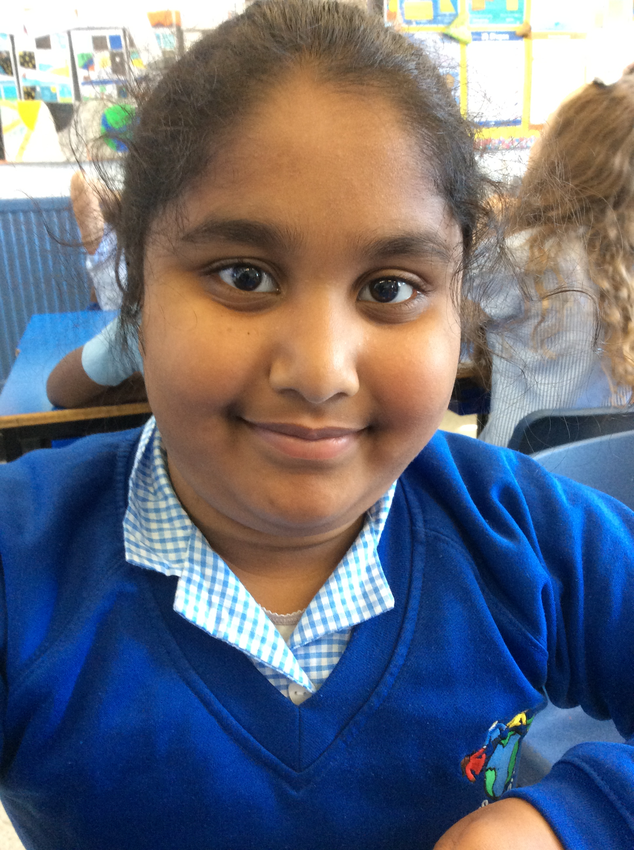
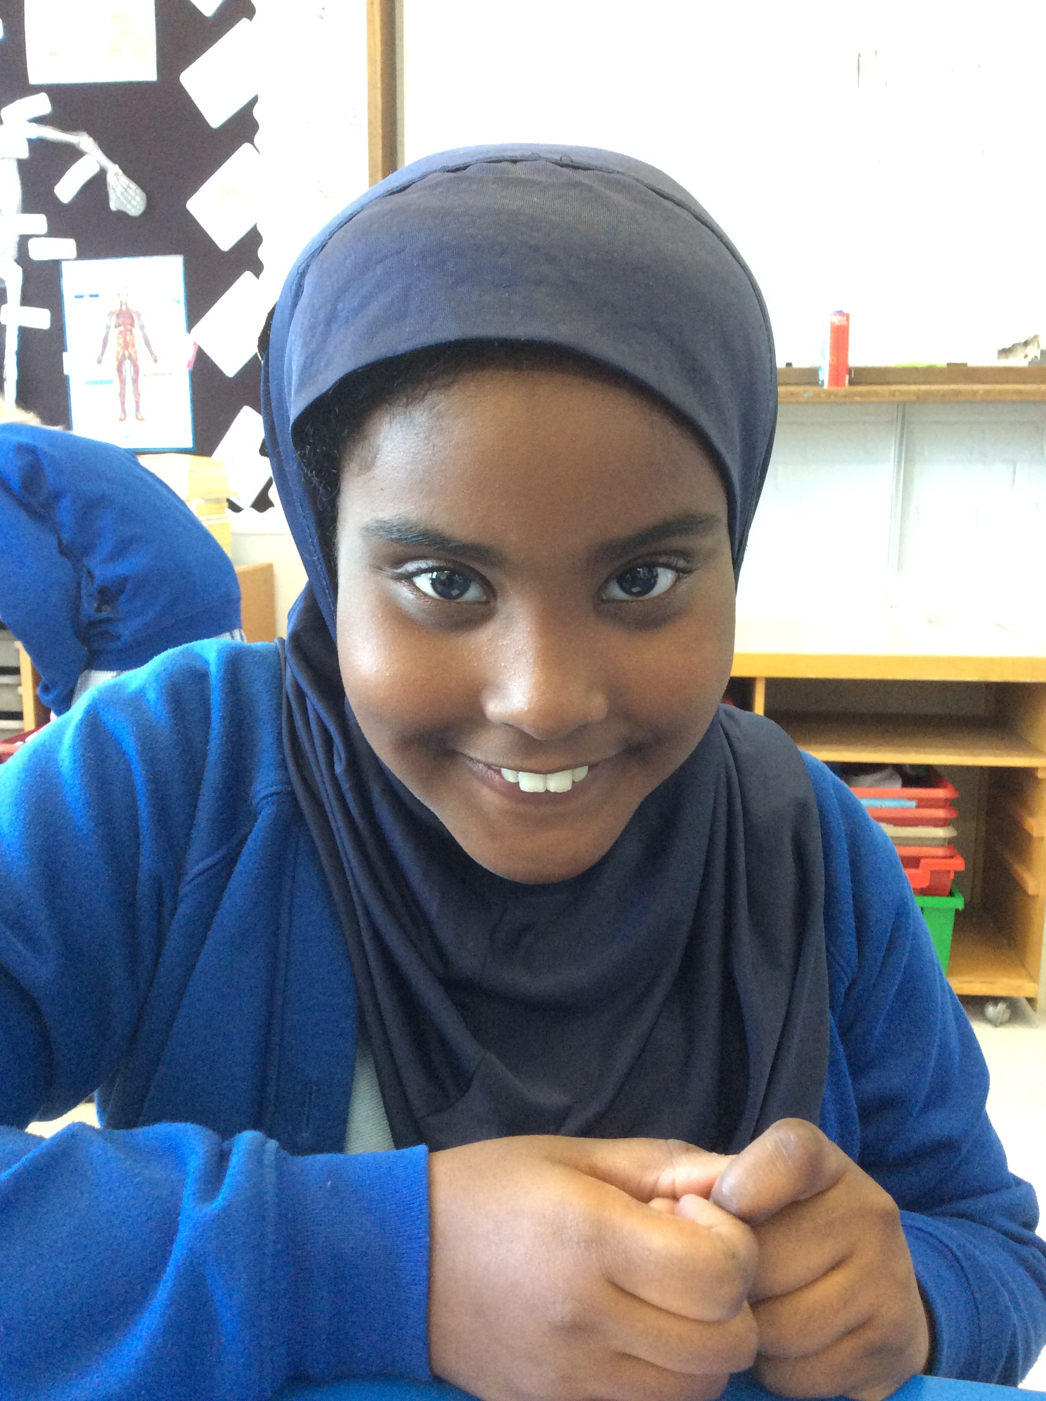
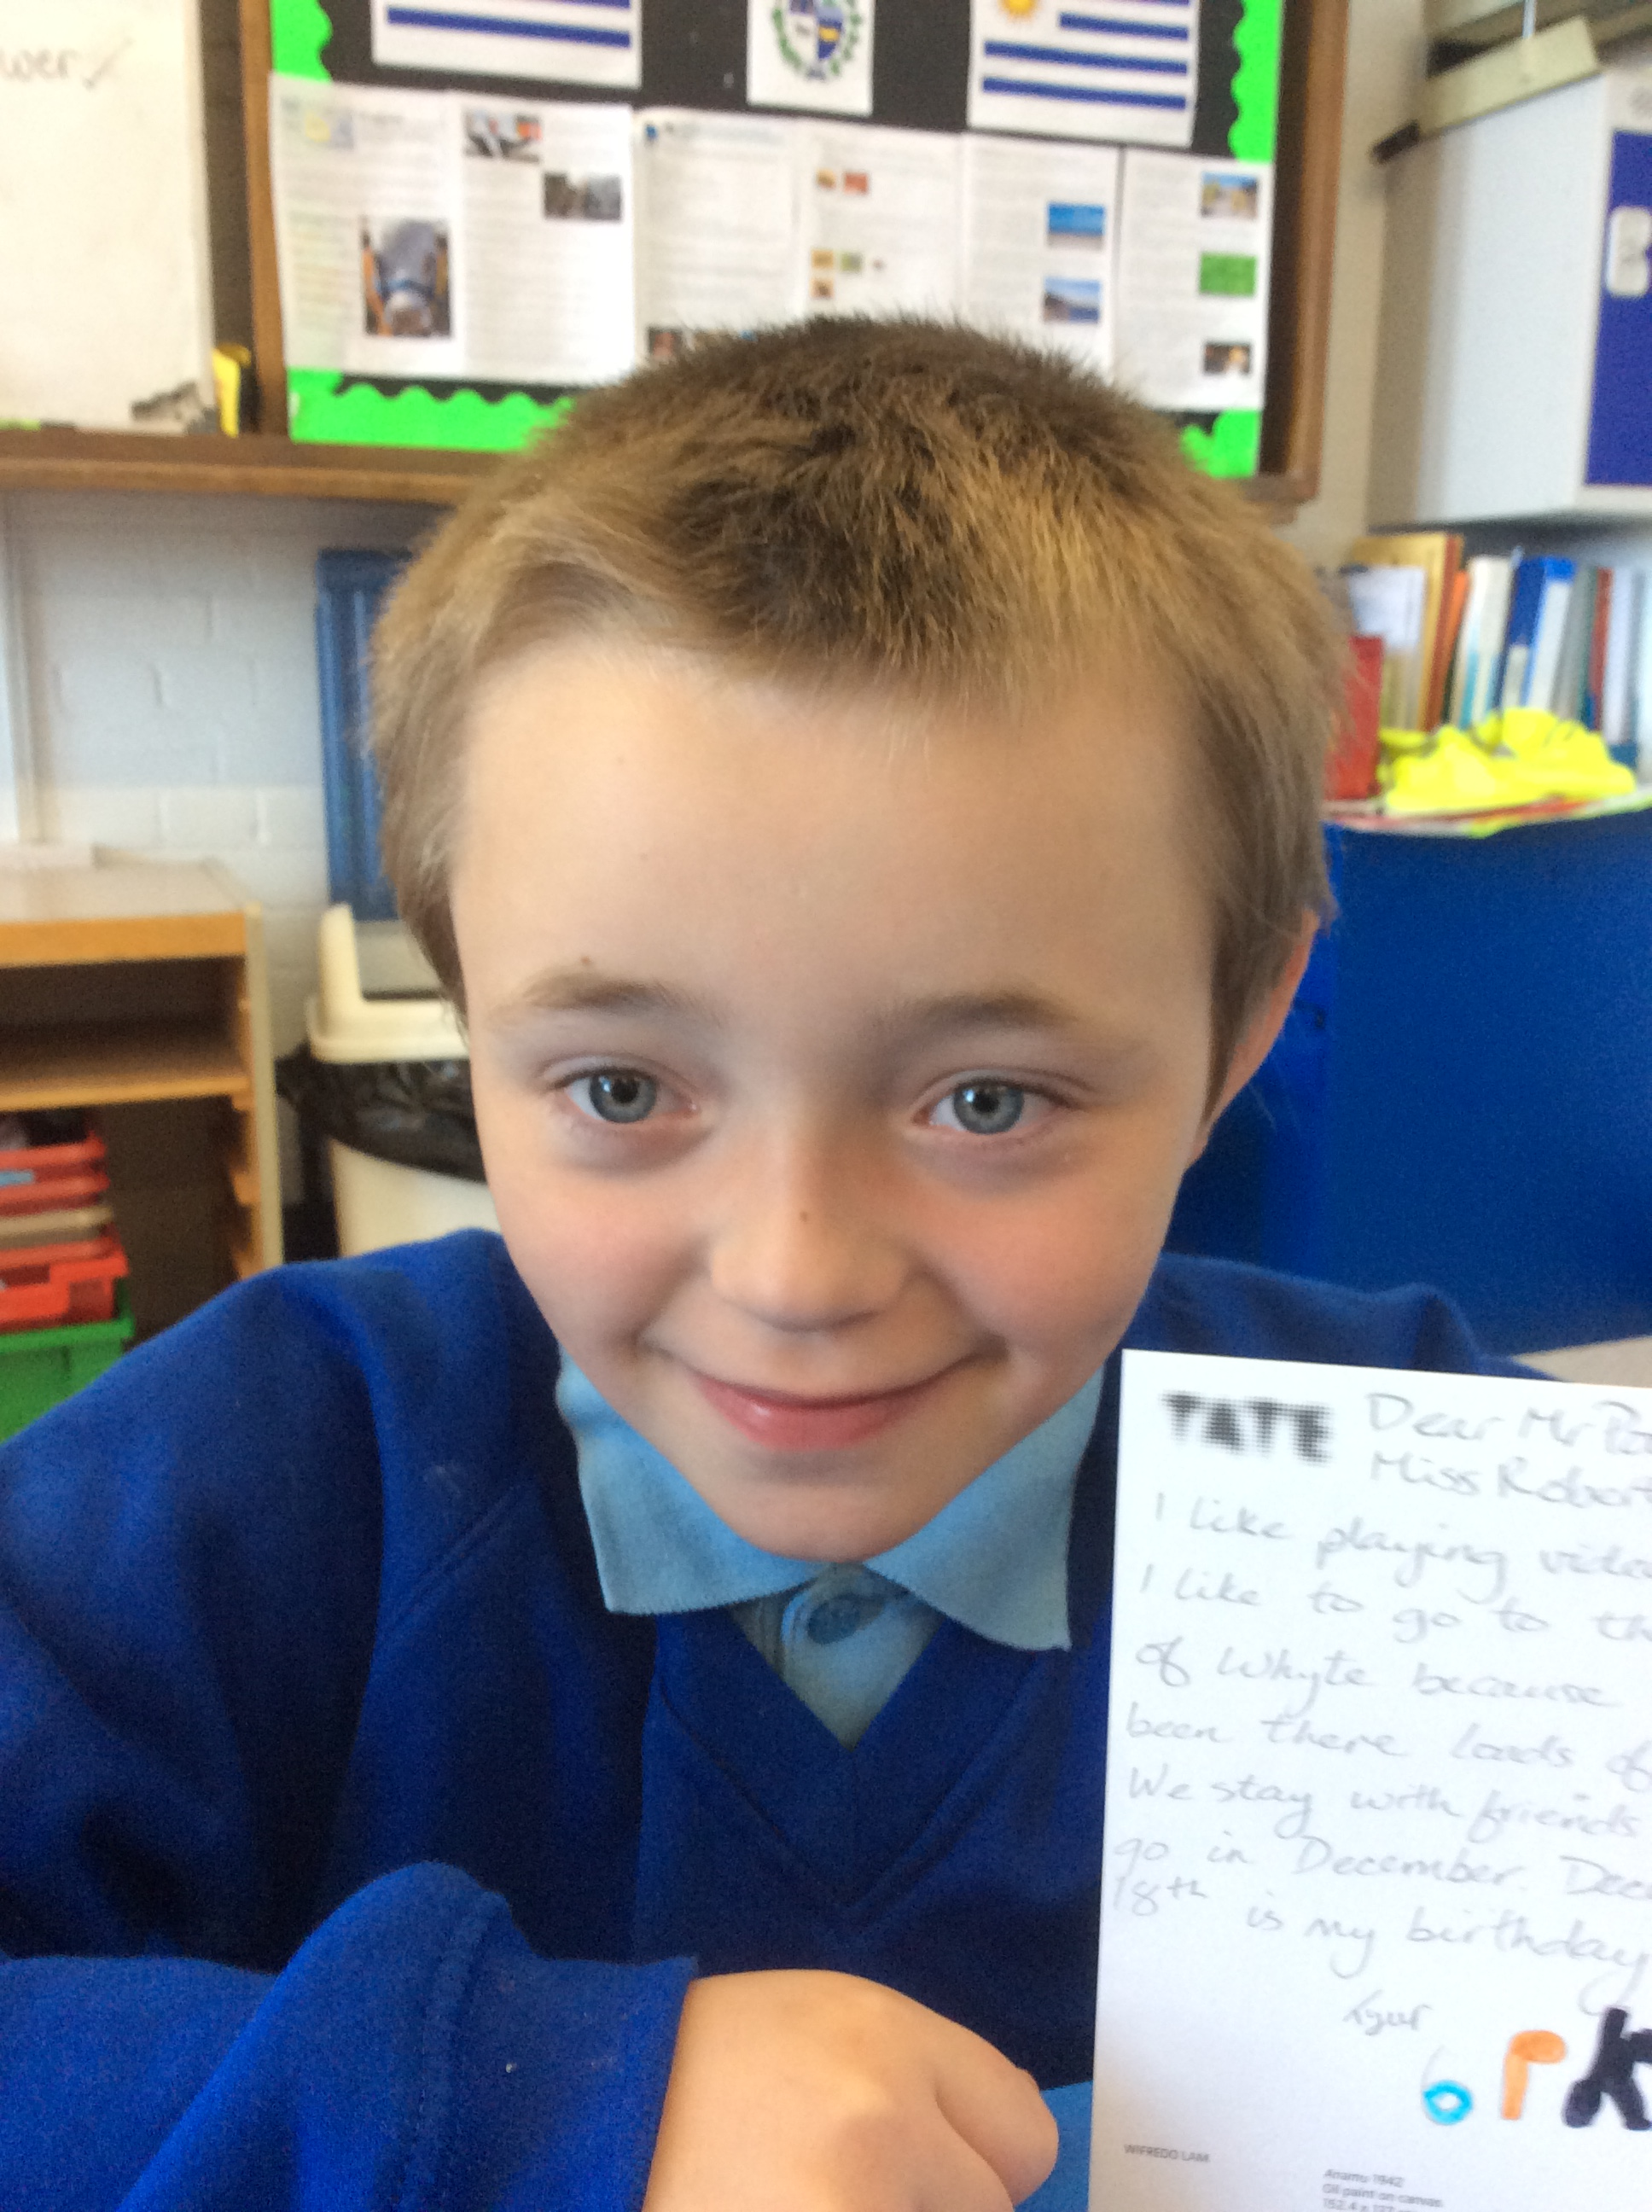
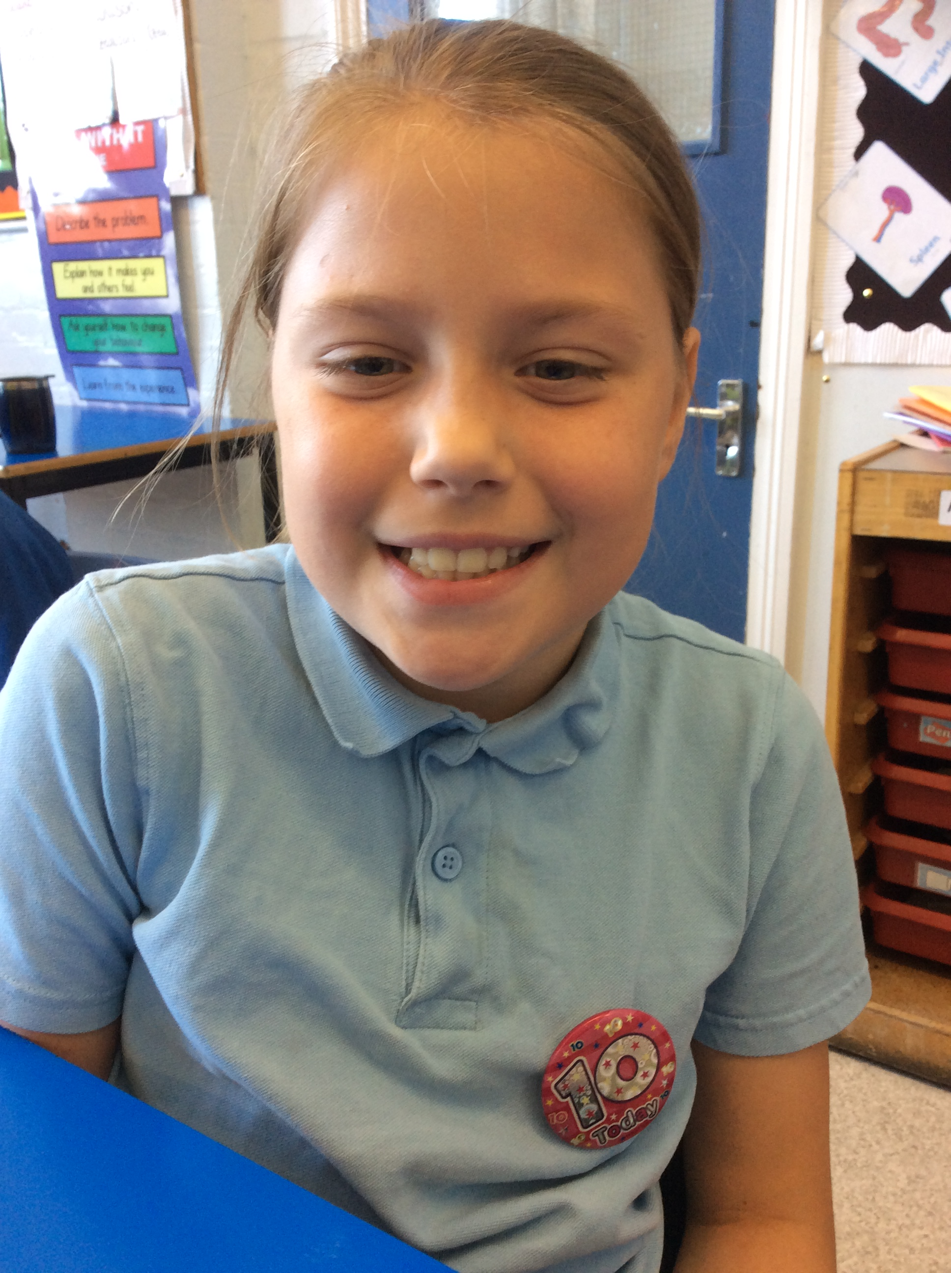
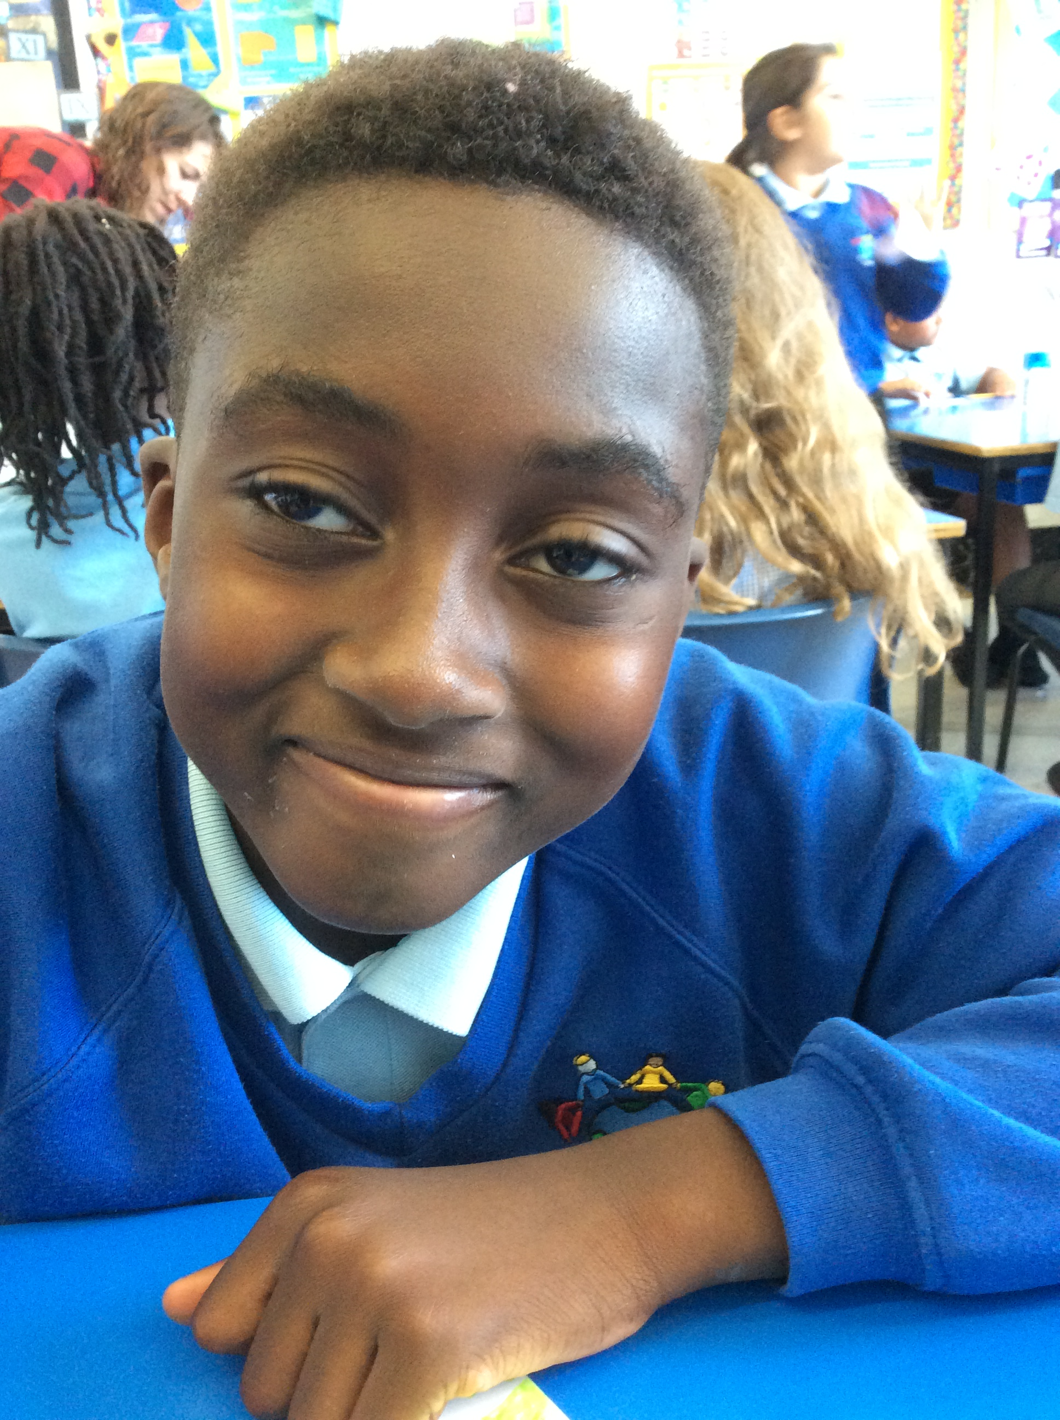
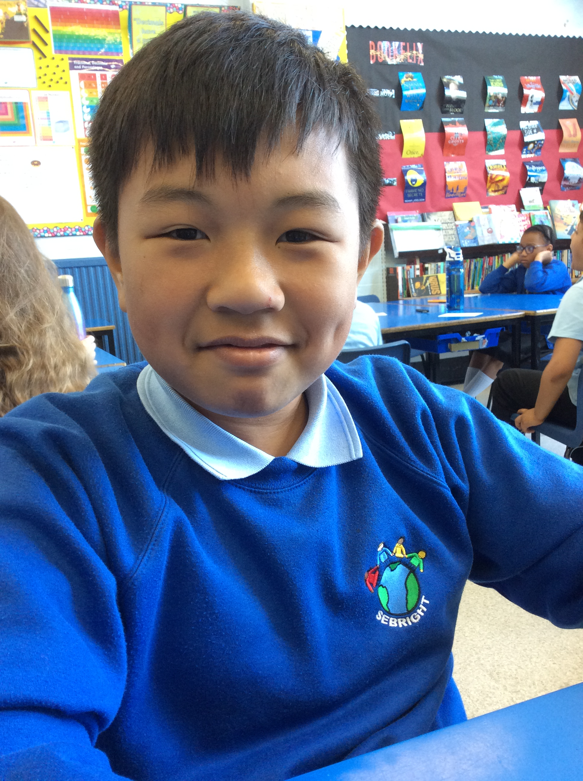
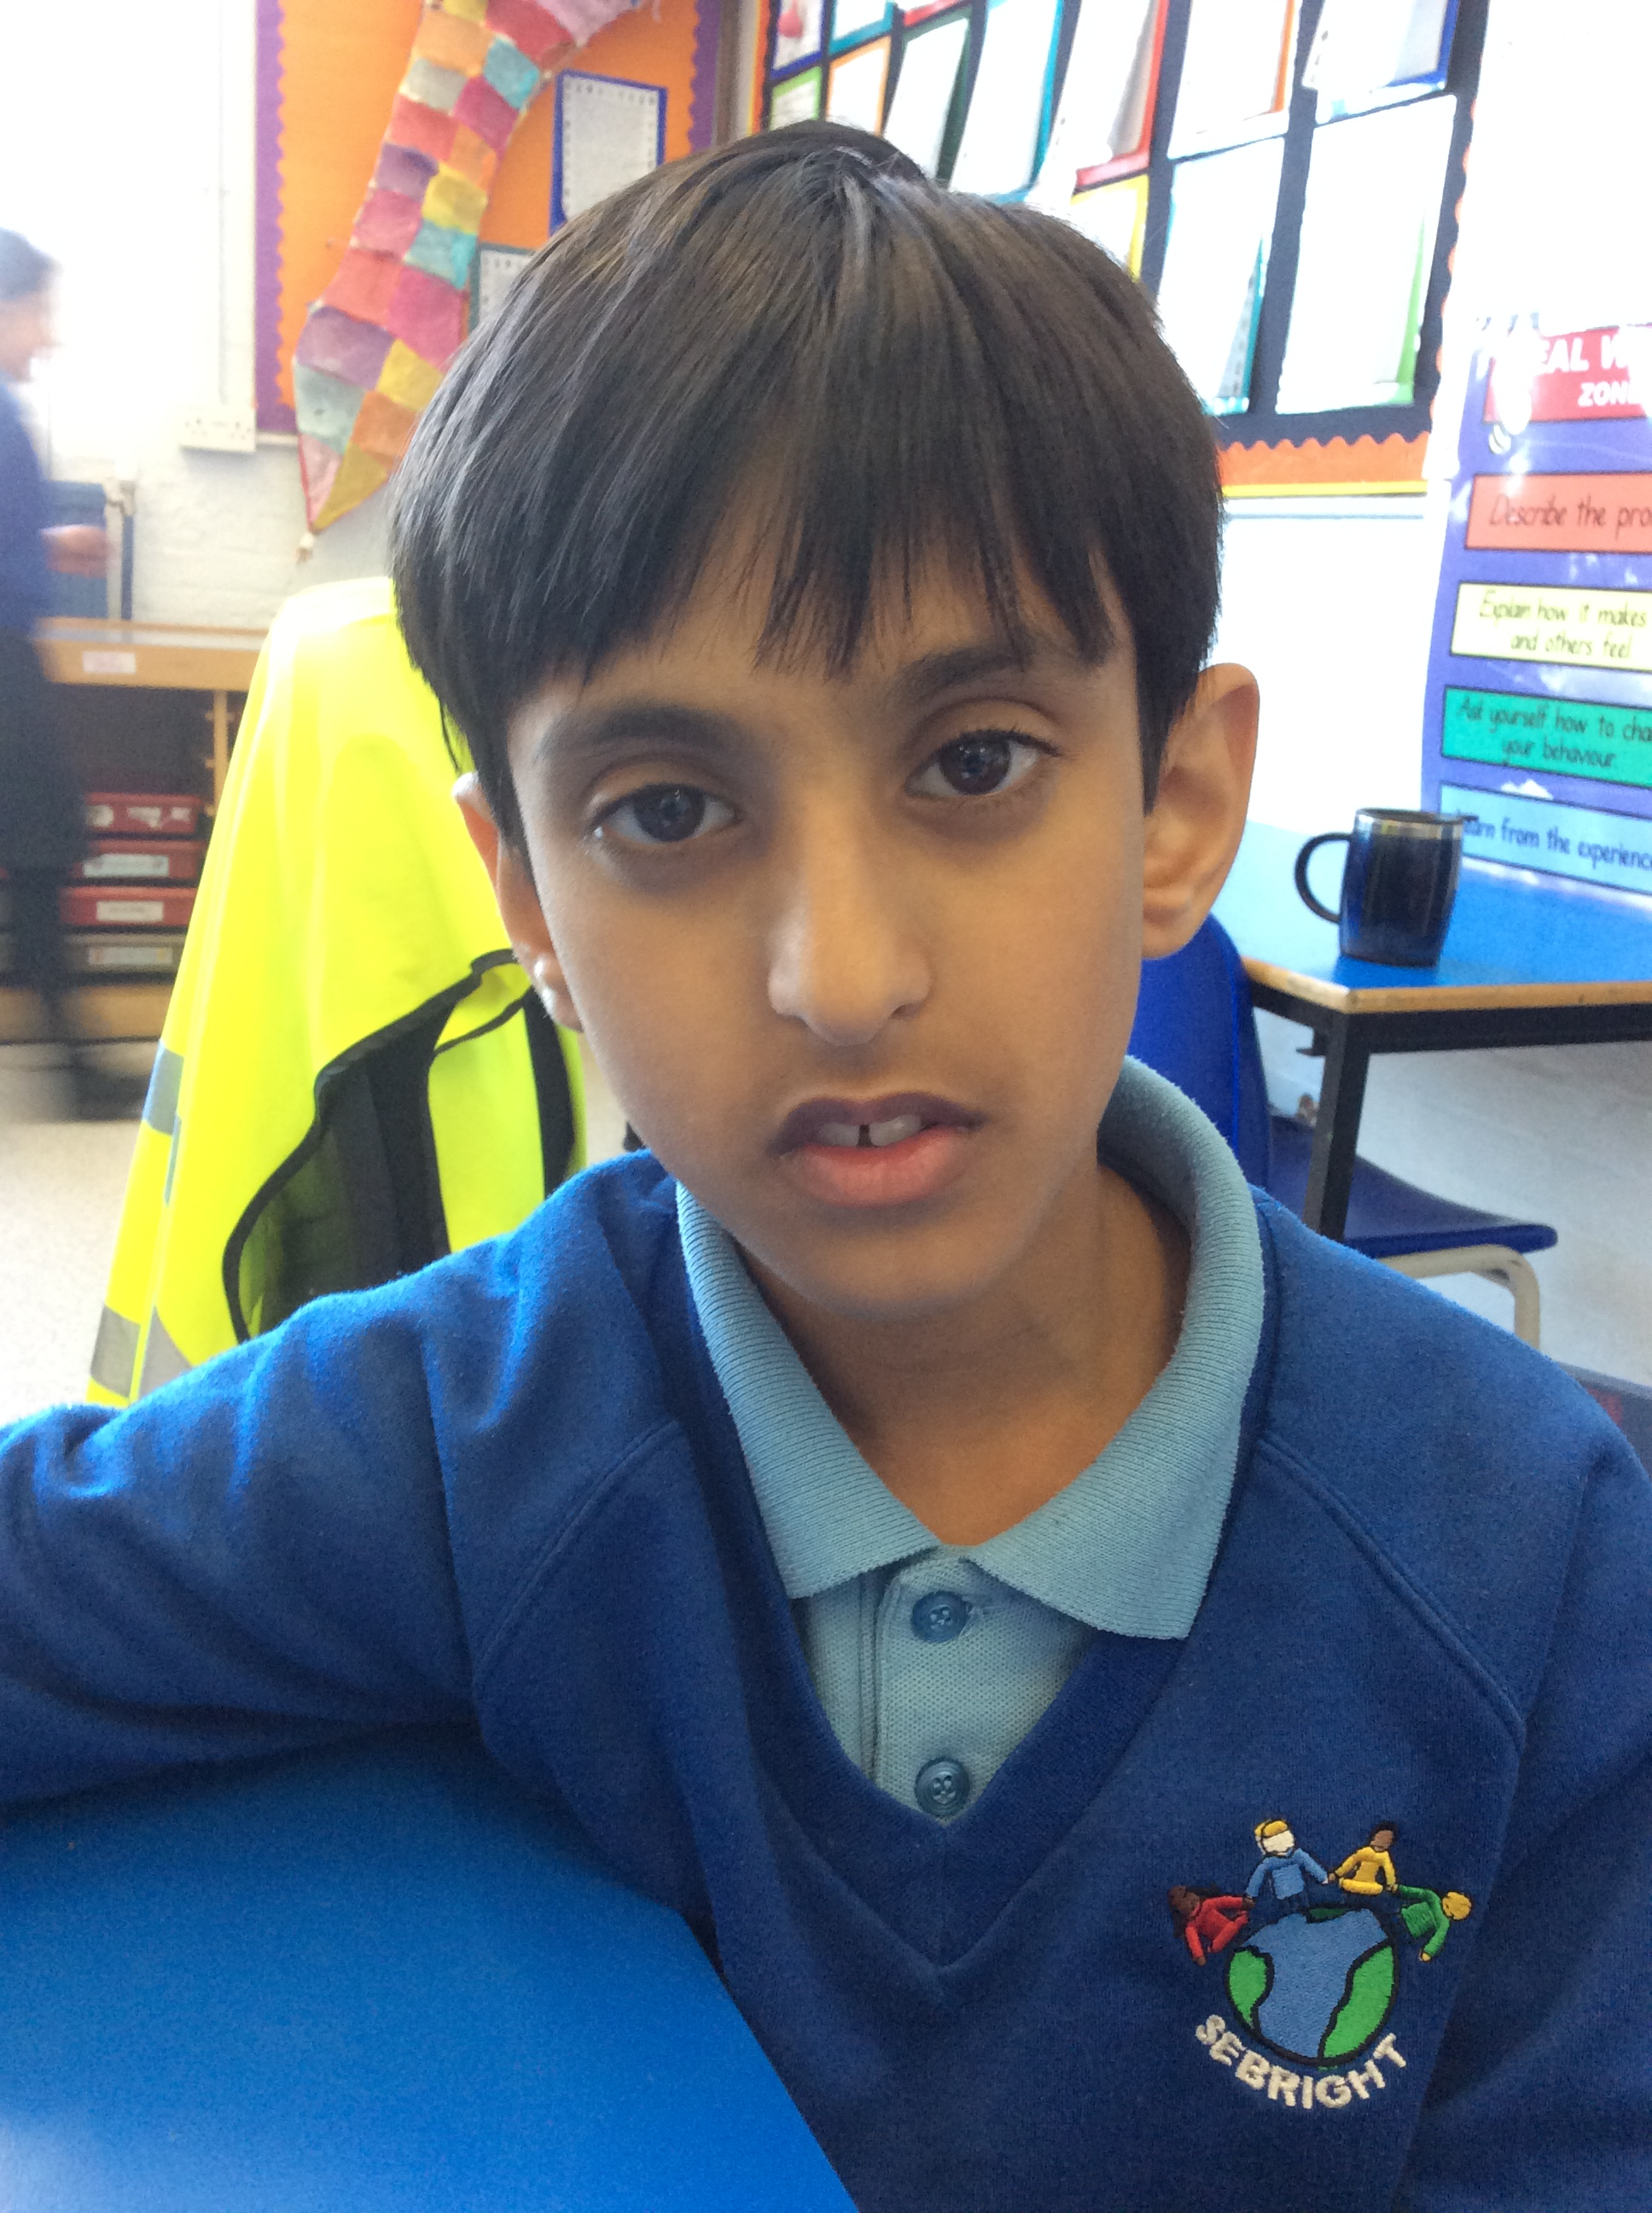
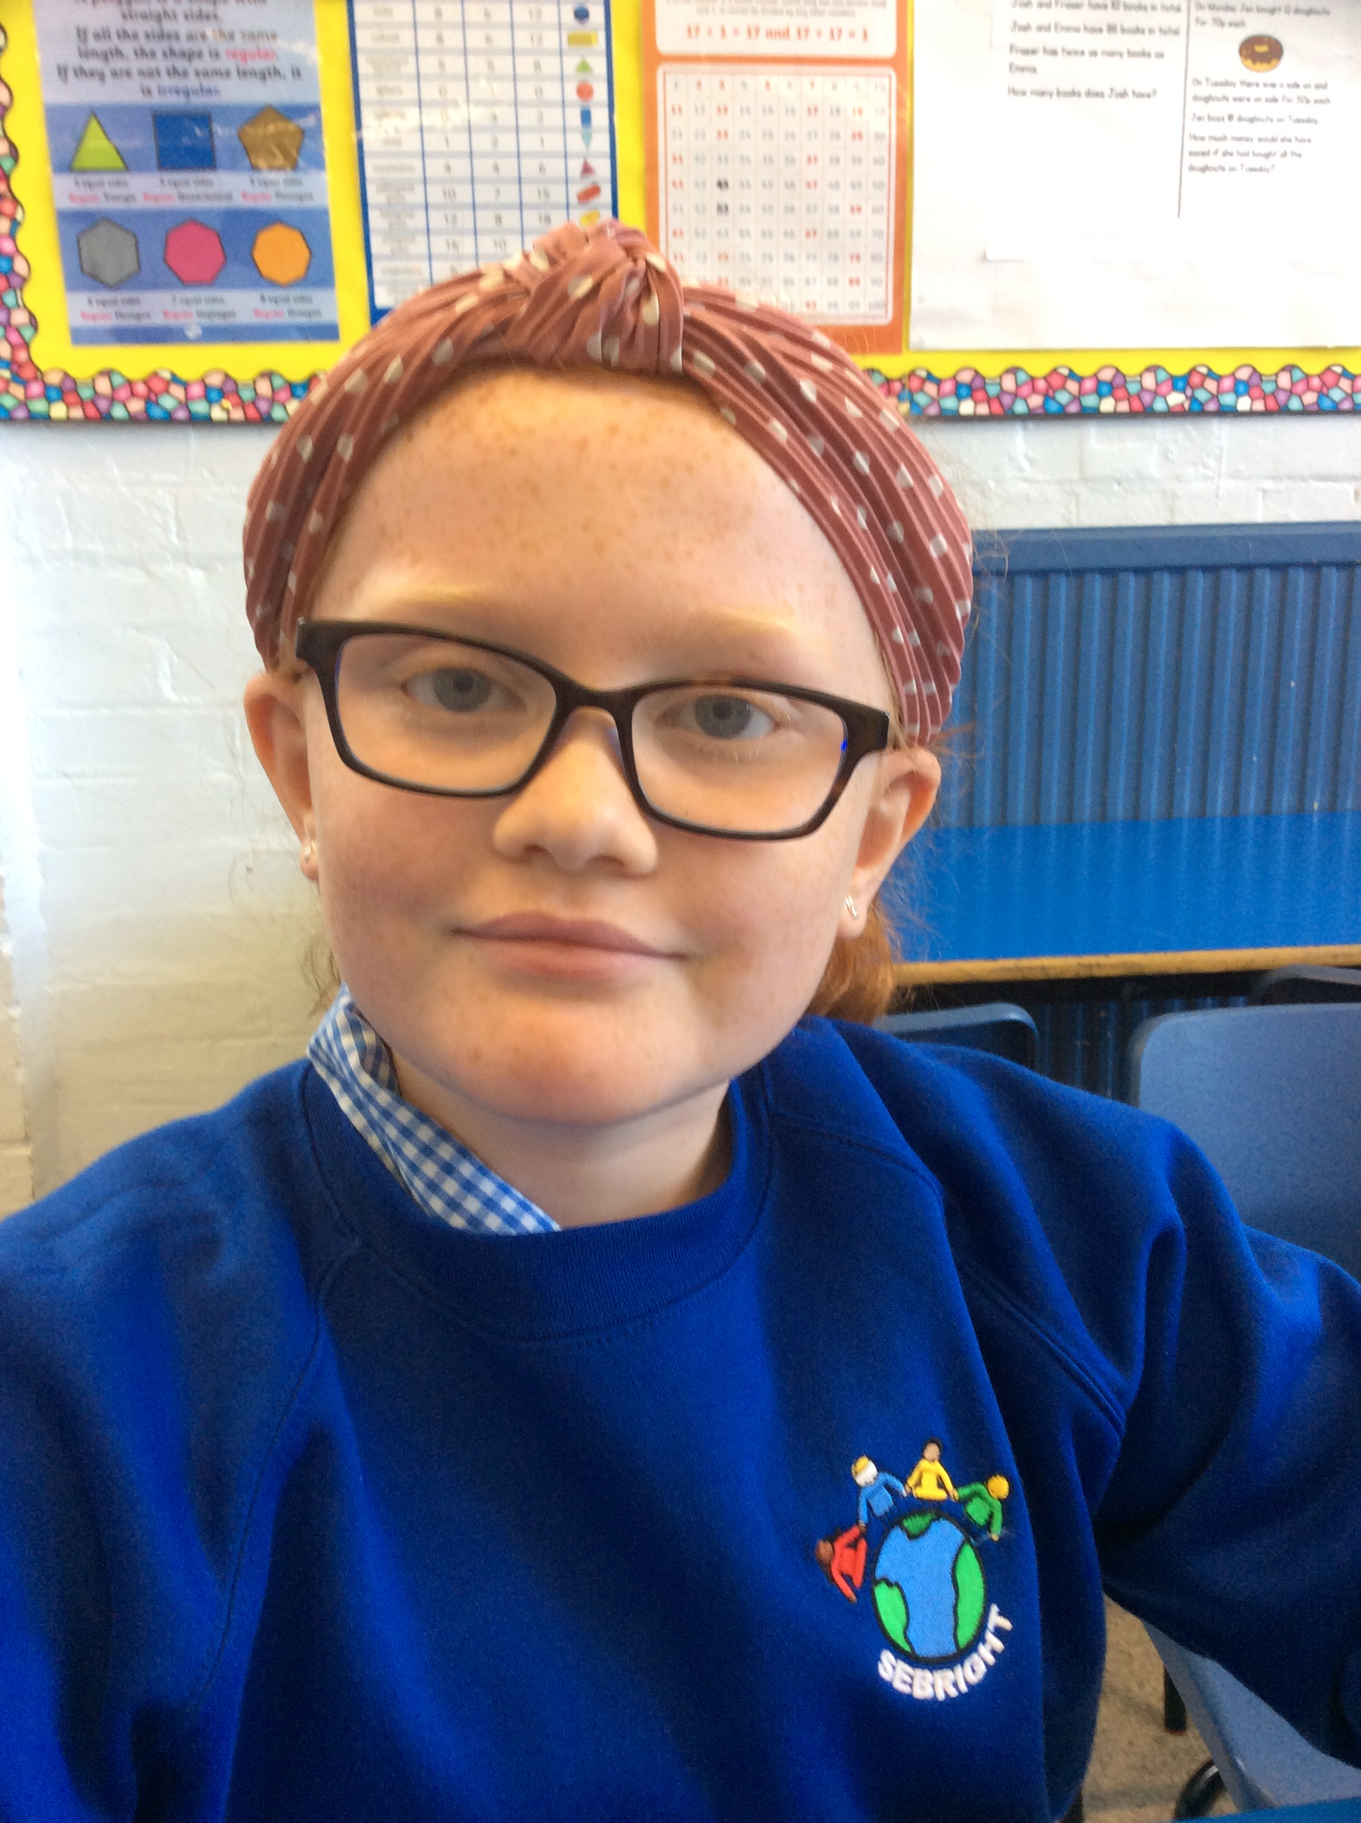
If I take a photo of a friend I am always well aware To ask if it’s okay with them Before I click and share.
6PR says… BE ONLINE SAFE!!
I keep my information to myself I don’t let people know: My name, address or number Or to which school I go.
I am always positive to others
In the playground and on screen
I never write or tell them things
That are hurtful, bad or mean.
I never ever talk to strangers. If they’re not a real-life friend Whoever they say they are It could be just a false alarm.
I always ask a trusted adult
Before I go online
So we can look at things together
I know I will be fine.
And if ever I see something
That makes me scared or sad
I tell a trusted adult
And it won’t be so bad

Slide 20
6PR says… BE SAFE ONLINE!!

